Slide 1
MIAB Orientation Networking Event - MO23
Sunday 7 January 2024, at 10:00am- 11:30 am
Co - Chairs: Xuejing (Amy) Yue and Professor Tony Stanco

Slide 2
Agenda
MIAB MFAc Orientation Networking Event - MO23
Sunday Jan 7, 2024, 10:00 am - 11:30 am
Co - Chair: Xuejing (Amy) Yue & Professor Tony Stanco
Presentation | Event Schedule
Welcome - Professor Tony Stanco | 3 mins, 10:05-10:08
1. Introduction to MIAB - Professor Taslima Nasreen | 7 mins, 10:08-10:15
2. Structure of MIAB – Antoinette Jacintho | 7 mins, 10:15-10:22
3. Introduction to FACC6850 - Professor Tony Stanco | 10 mins, 10:22-10:32
4. MIAB Website - Amy Yue | 10 mins, 10:32-10:42
5. Career Skills Sessions - Yuxi (John) Lin | 7 mins, 10:42-10:49
Break | 10 mins, 10:49-10:59
6. Student Interface - Krystal | 7 mins, 10:59-11:06
7. Employer Interface - Kris | 7 mins, 11:06-11:13
8. Intern and Adviser Placement Coordinator - Felix | 7 mins, 11:13-11:20
9. Alumni and Mentoring - Mark & Judith | 7 mins, 11:20-11:27
10. Completion of survey - Yuxi (John) Lin | 3mins, 11:27-11:30

Slide 3
Welcome
Professor Tony Stanco​

Slide 4
Welcome & Introduction to MIAB
Professor Taslima Nasreen

Slide 5
Master of Financial Accountability Internship Advisory Board (MIAB)
MIAB is a not-for-profit organization created in August 2019
to facilitate MFAc Students' success by providing more employment opportunities (co-op, internships and graduate jobs) and career skill development opportunities.
Runs completely on a voluntary basis with the assistance of
professors,
students,
MFAc alumni,
employers and
the York University administration.

Slide 6
MIAB facilitates your internships
Start seeking an internship as soon as you can
Coop permits usually required for international students
Consider a MIAB unpaid internship (no co-op permit)
FACC6850 PROP is here to help you
Read students section of MIAB site (especially Q&As)
300 hours minimum
You can do multiple internships

Slide 7
MIAB facilitates your internships
Communicating with employers, alumni and students & facilitating contact between them
Maintaining an up-to-date website containing relevant information
Career skills program
Alumni mentoring program

Slide 8
Examples in employers
Angel Foundation | Accounting Plus Financial Services*
CCUE Finance | Adopt4Life
GoBest Immigration Consultants* | All Nations International Development Agency
Hungry Panda Tech Ltd. | Corporate Knights (ranks companies' effectiveness in dealing with environmental issues)
Toronto Hydro* | Doctors for Doctors
Bank of Montreal* | et al. (start-up club/bistro for faculty and graduate students) (5)
MIAB | SQL Power Group*
Maison Brison* | MFAc Internship Advisory Board
Ontario Energy Board* | Ministry of Infrastructure (Government of Ontario)*
Open Text Corporation* | New Field International Education*
Unilever Canada* | Open Text Corporation*
CBRE* | Power Career Education and Technology Inc. (Career coaching)*
HSBC* | Quality Online Education Group (International online educator)
PointA | Royal Bank of Canada*
New Matrixus Consulting | Scotiabank*
Global Smart Education Alliance* | Toronto Foundation
Travelers* Liberty Utilities* Mackenzie Financial* MRKT360* | Toronto Renewable Energy Cooperative (specilizes in facilitating social financing)
* Paid. | VirgoCX (Blockchain and bitcoin facilitator)*
Angel Foundation | Warden Woods Community Centre

Slide 9
For further information, please email to
miabstud@yorku.ca
Or visit:
https://miab.info.yorku.ca/

Slide 10
Structure of MIAB
HR Coordinator, Antoinette Jacintho

Slide 11
Human Resource Coordinator– MIAB HR
Be the main staff support and administer the work of the Human Resources Working Group (HRWG).
Review and make sure that our schedules of meeting times and significant future events are up to date and suitable for planning future MIAB activities.
Attend frequent meetings of the Internship Staff Working Group (IntWG) and the Administration and Communications Working Group.
Attend other working groups and boards as and when required or useful.
Update MIAB’s human resources records in collaboration with the MIAB Chair.
Ensure meeting reminders are sent, minutes are prepared and reviewed, and agendas are updated for all Working Group and Board meetings.
Serve as a backup to the other three other members of A&C as and when required.
Participate in recruitment, health and safety protocols, obligation agreements, employee relations, confidentiality agreements and other human resources tasks.

Slide 12
MFAc Internship Advisory Board
(MIAB)
Constituency Groups
Activities
Advisory Working Groups
Human Resources Working Group
(300 hour internships)
Staff Working Groups
FACC6850 Representatives
Alumni Board
Eshan Bhurton
Mike Mokhtar
Internship Arranging
Branding & Communications/Website
Alumni & Mentoring
Mark Gyamfi
Judith Naa Laingoi Ayiku
Course Coordinator
Professor K Paul Evans
Admin & Communications
Faculty & Employer Board
Being Formed
Career Skills Sessions
Careers Development
Communications
Liyuan (Geoffrey) Gu
Course MIAB CEO Director
Professor Taslima Nasreen
Internship
Student Society
Contact = Feiyu Chen
Mentoring
Alumni & Mentoring
Course Director
Professor Tony Stanco
Sessions
Yuxi (John) Lin
Heyue (Cathy) Ding
Awards Committee
President
Feiyu Chen
Briefing, Employer & Other Events & Sessions
Internship Advisory
Structure of MIAB
Record Keeping Coordinator
Md Jahirul Islam
LinkedIn Committee
Supporting Course Director
Professor Haiping Wang
Vice-President
Jiahui (Kellen) Lou
Monthly MFAc student newsletters
Human Resources
Tianyi (Lucia) Hong
Antionette Jacintho
Internship Research Assistant
Damilola (Dammy) Aderemi Atekoja
Secretary
Junhao (Tracy) Huang
Alumni Newsletters
Initial Internship Coordinator
Wenxuan (Wade) Wei
Nana Yaw Amoako-Fordwour
Marketing Officer
Ke (Kira) Ren
Yan (Joanna) Zhao
)
Websites & Linkedln
Admin & Comm
Research Assistant
Yufei (Freya) Jiang
Employer Contact
Jiajun (Justin) Hu
Chunhao (Kris) Jiang
Ying (Chole) Liu
Treasury
Damilola Atekoja
Student Contact
Zixuan (Krystal) Wang
MIAB is entirely staffed by volunteers
File is in Reference Documents SharePoint
MIAB reports to the Graduate Program Director via the FACC6850 course directors
This version is as of 4 Jan 2024
Internship Contacts
Felix Amanor Otu
Gunel Guluzade
Alumni Adviser
Hanan Ali (Saber)

Slide 13
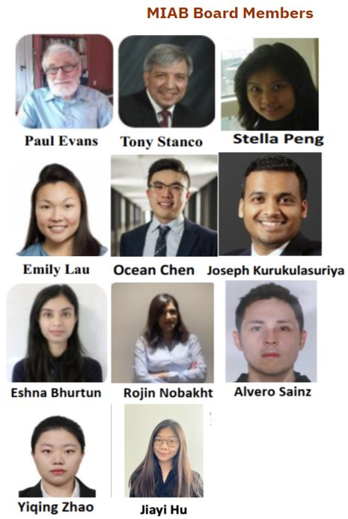
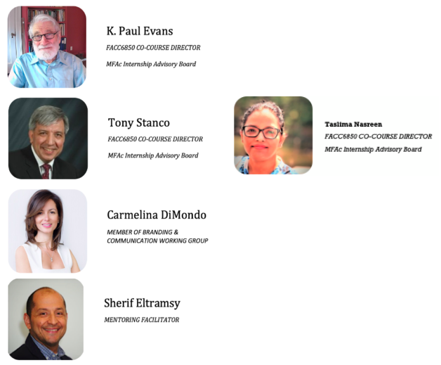
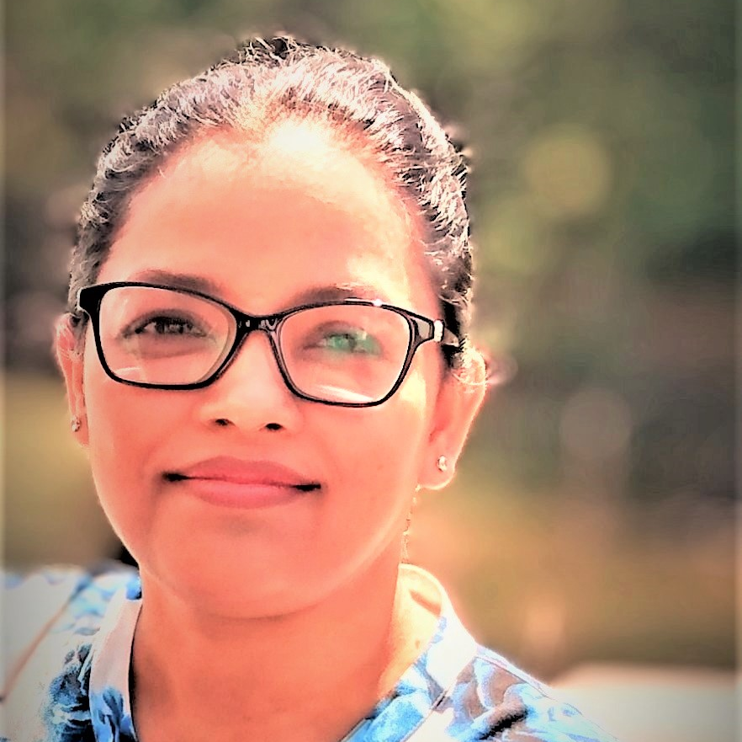
MIAB Board Members
Professors
Volunteers
Welcome to join us as a volunteer as well!
Taslima Nasreen

Slide 14
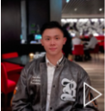
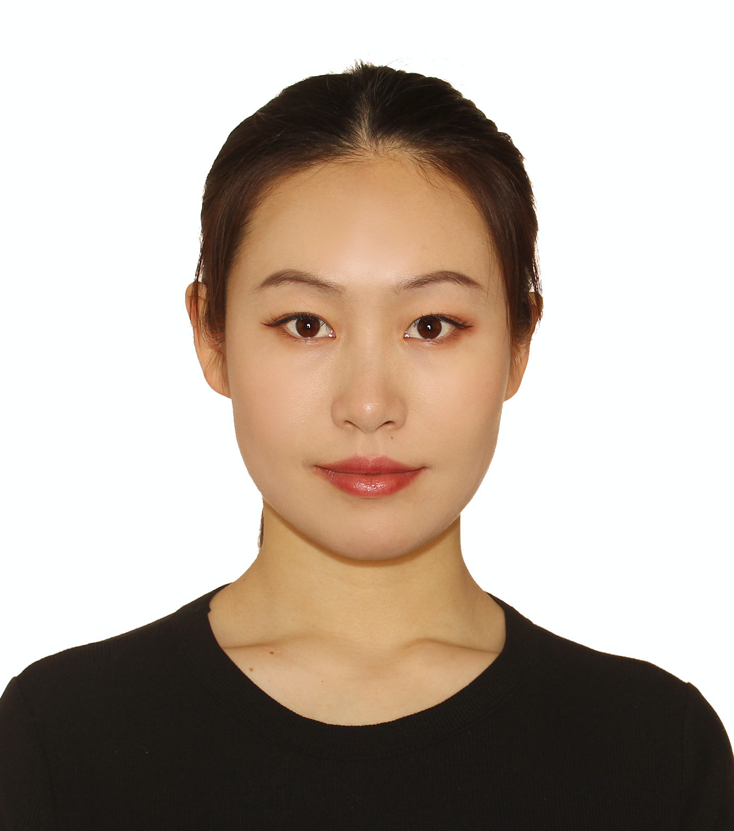
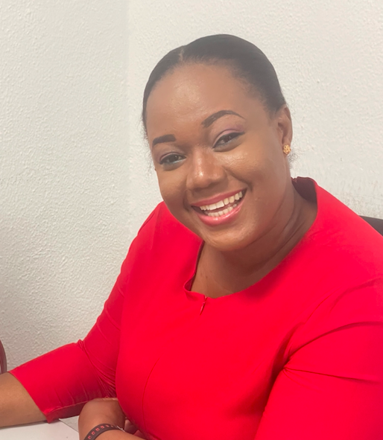
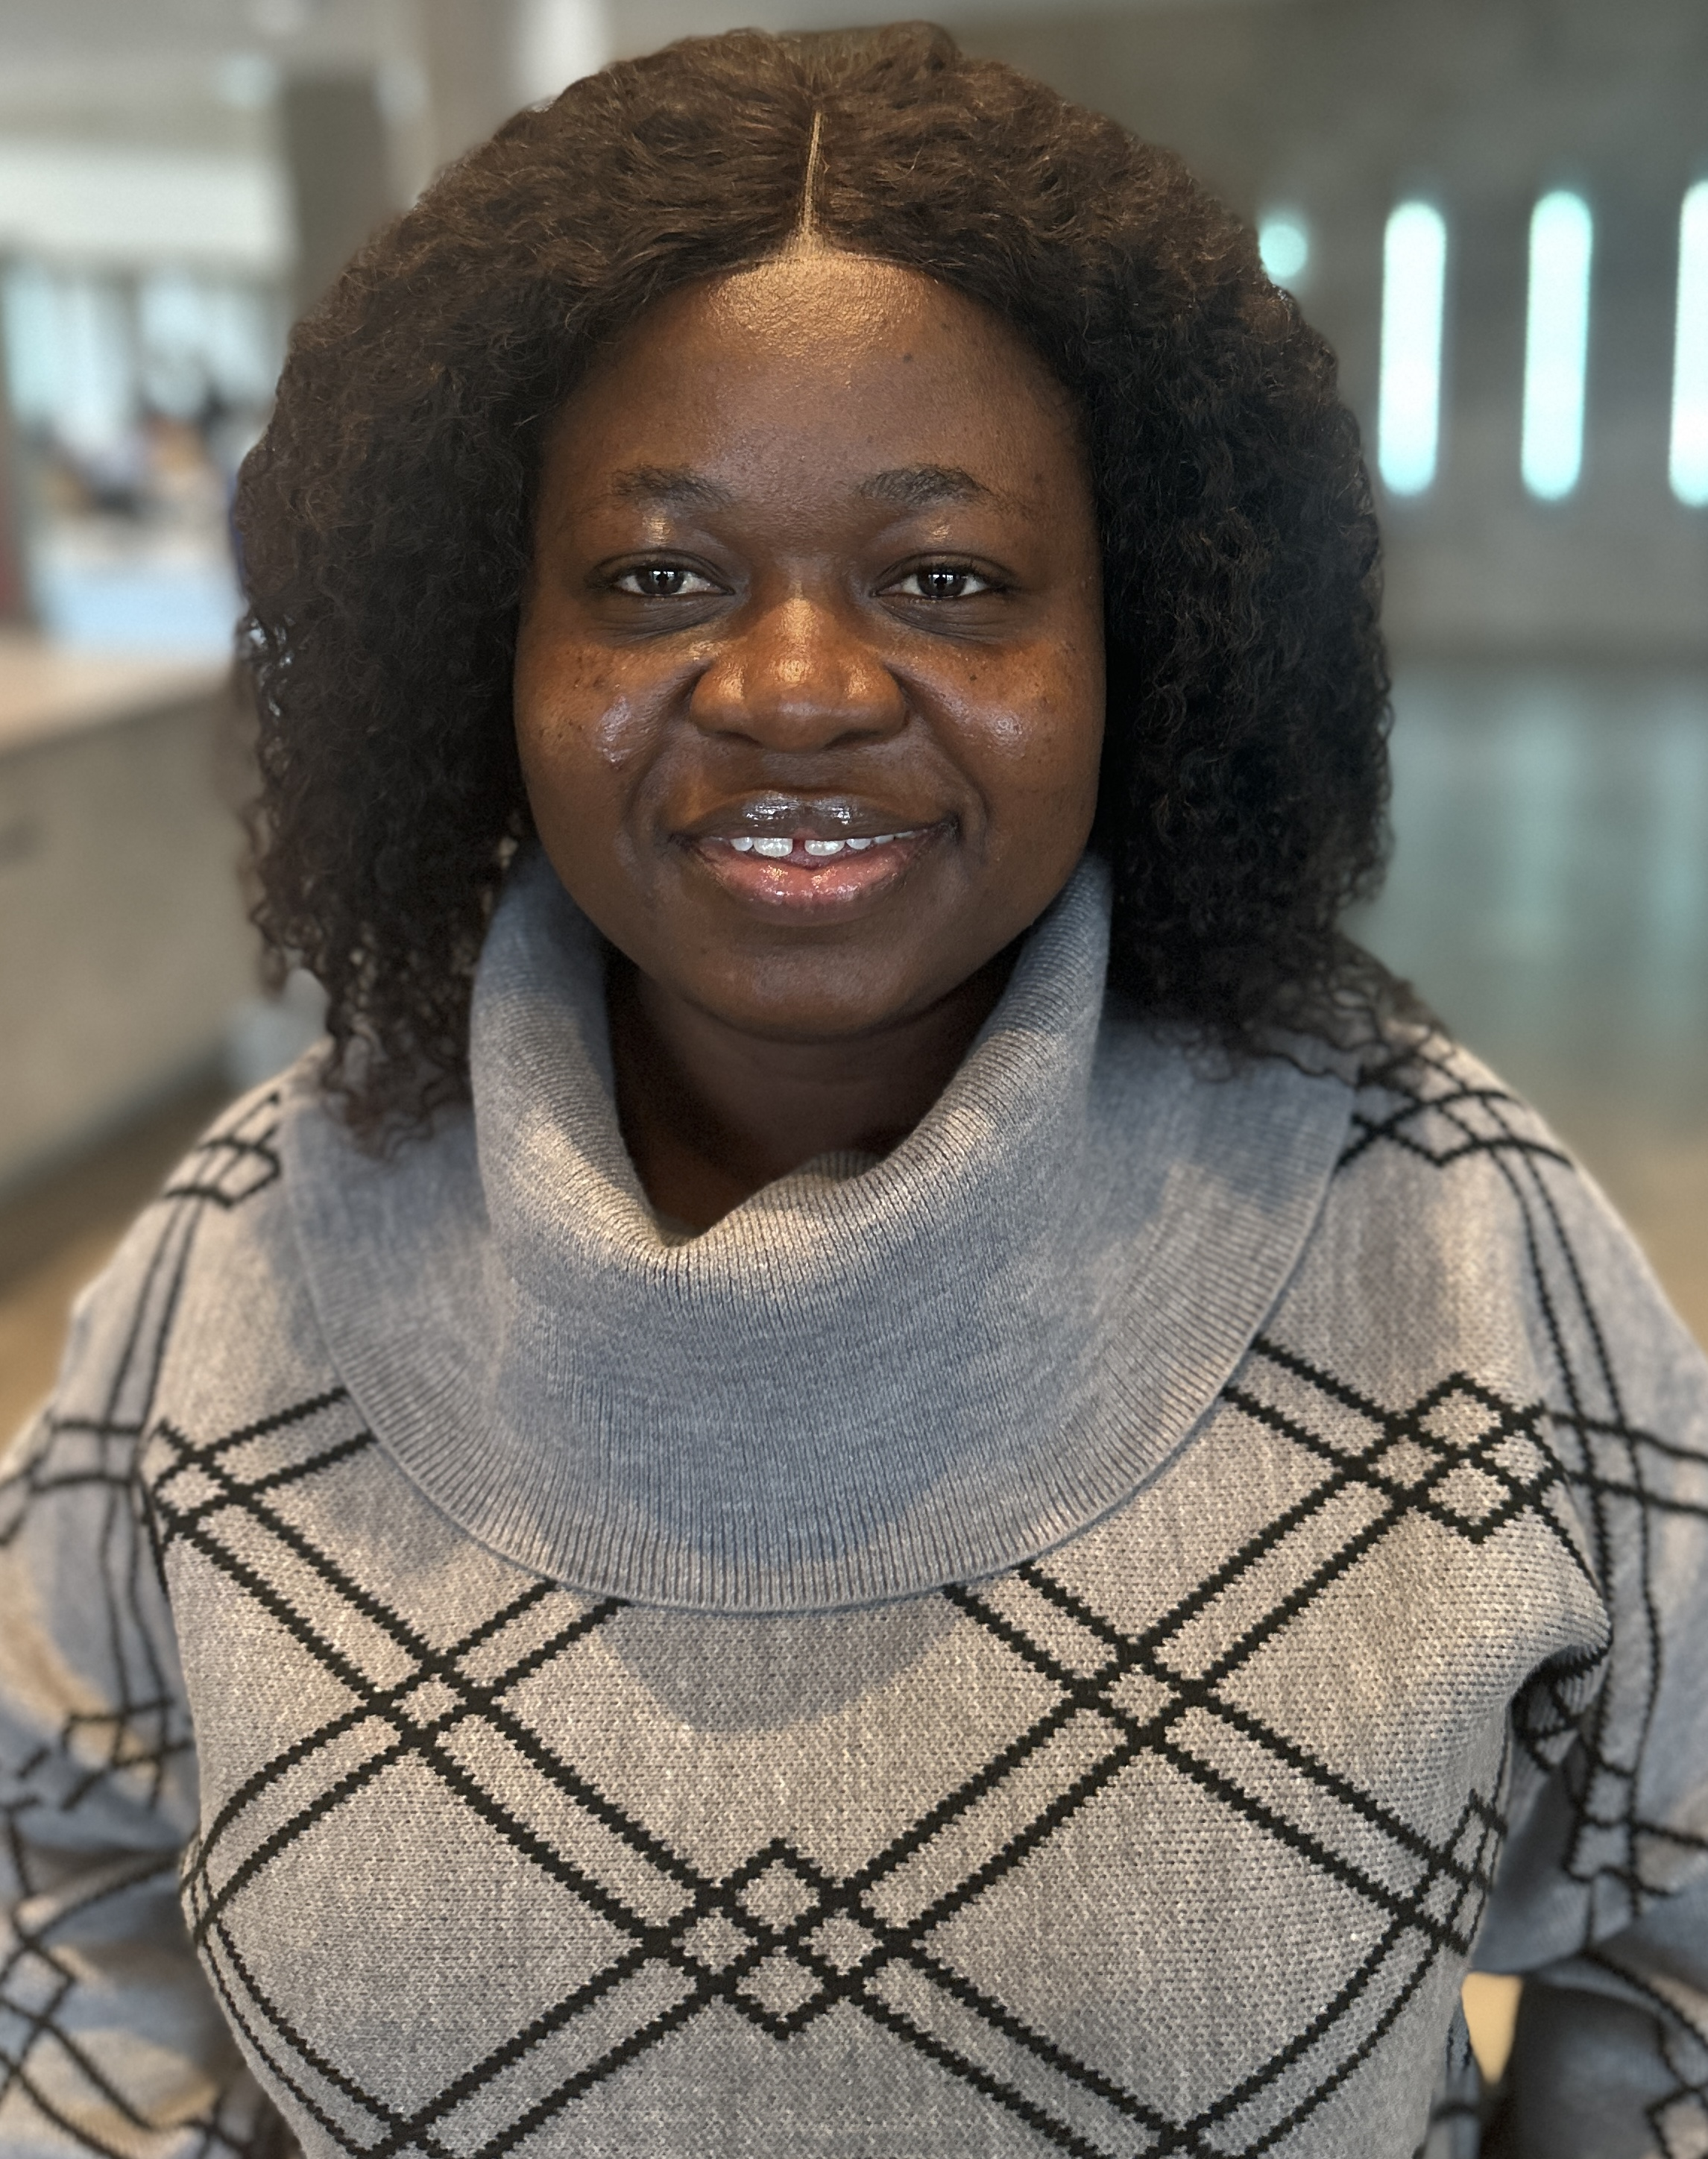
Our Coordinators
Yufei (Freya) Jiang
Research Assistant (2024 Winter)
Damilola Atekoja
Research Assistant
Yuxi (John) Lin
Sessions & Events Coordinator
Heyue (Cathy) Ding
Sessions & Events Coordinator
Tianyi (Lucia) Hong
Human Resource Coordinator
Chunhao (Kris) Jiang
Employer contact Coordinator
Mark Gyamfi
Alumni & Mentoring Coordinator
Judith Naa Laingoi Ayiku
Mentoring Coordinator
Antoinette Jacintho
Human Resource Coordinator
Zixuan (Krystal) Wang
Student contact Coordinator

Slide 15
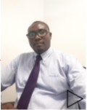
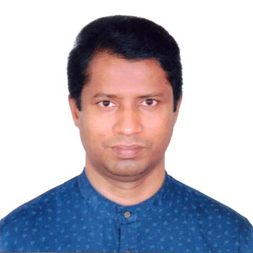
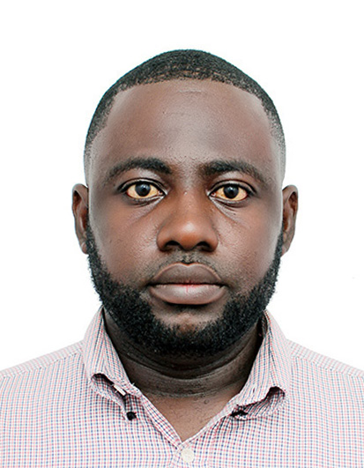
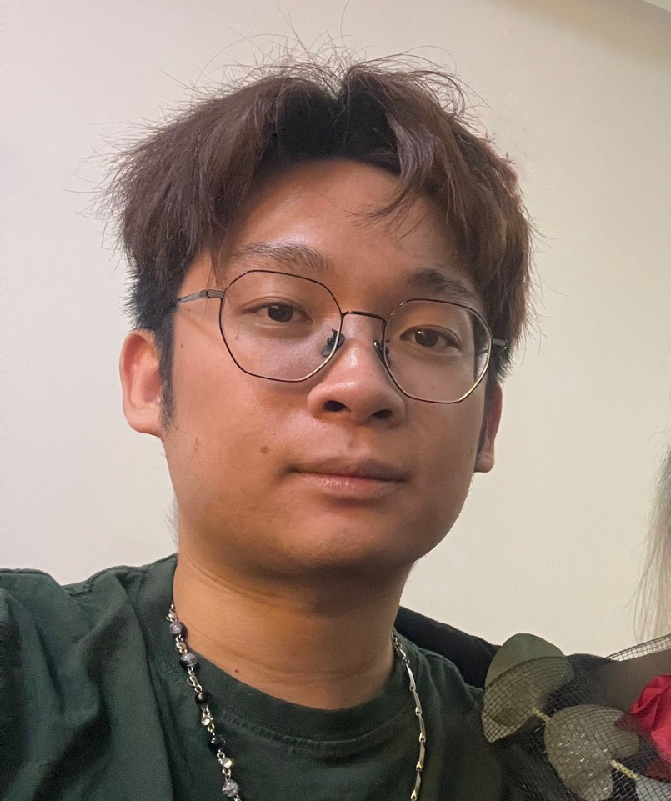
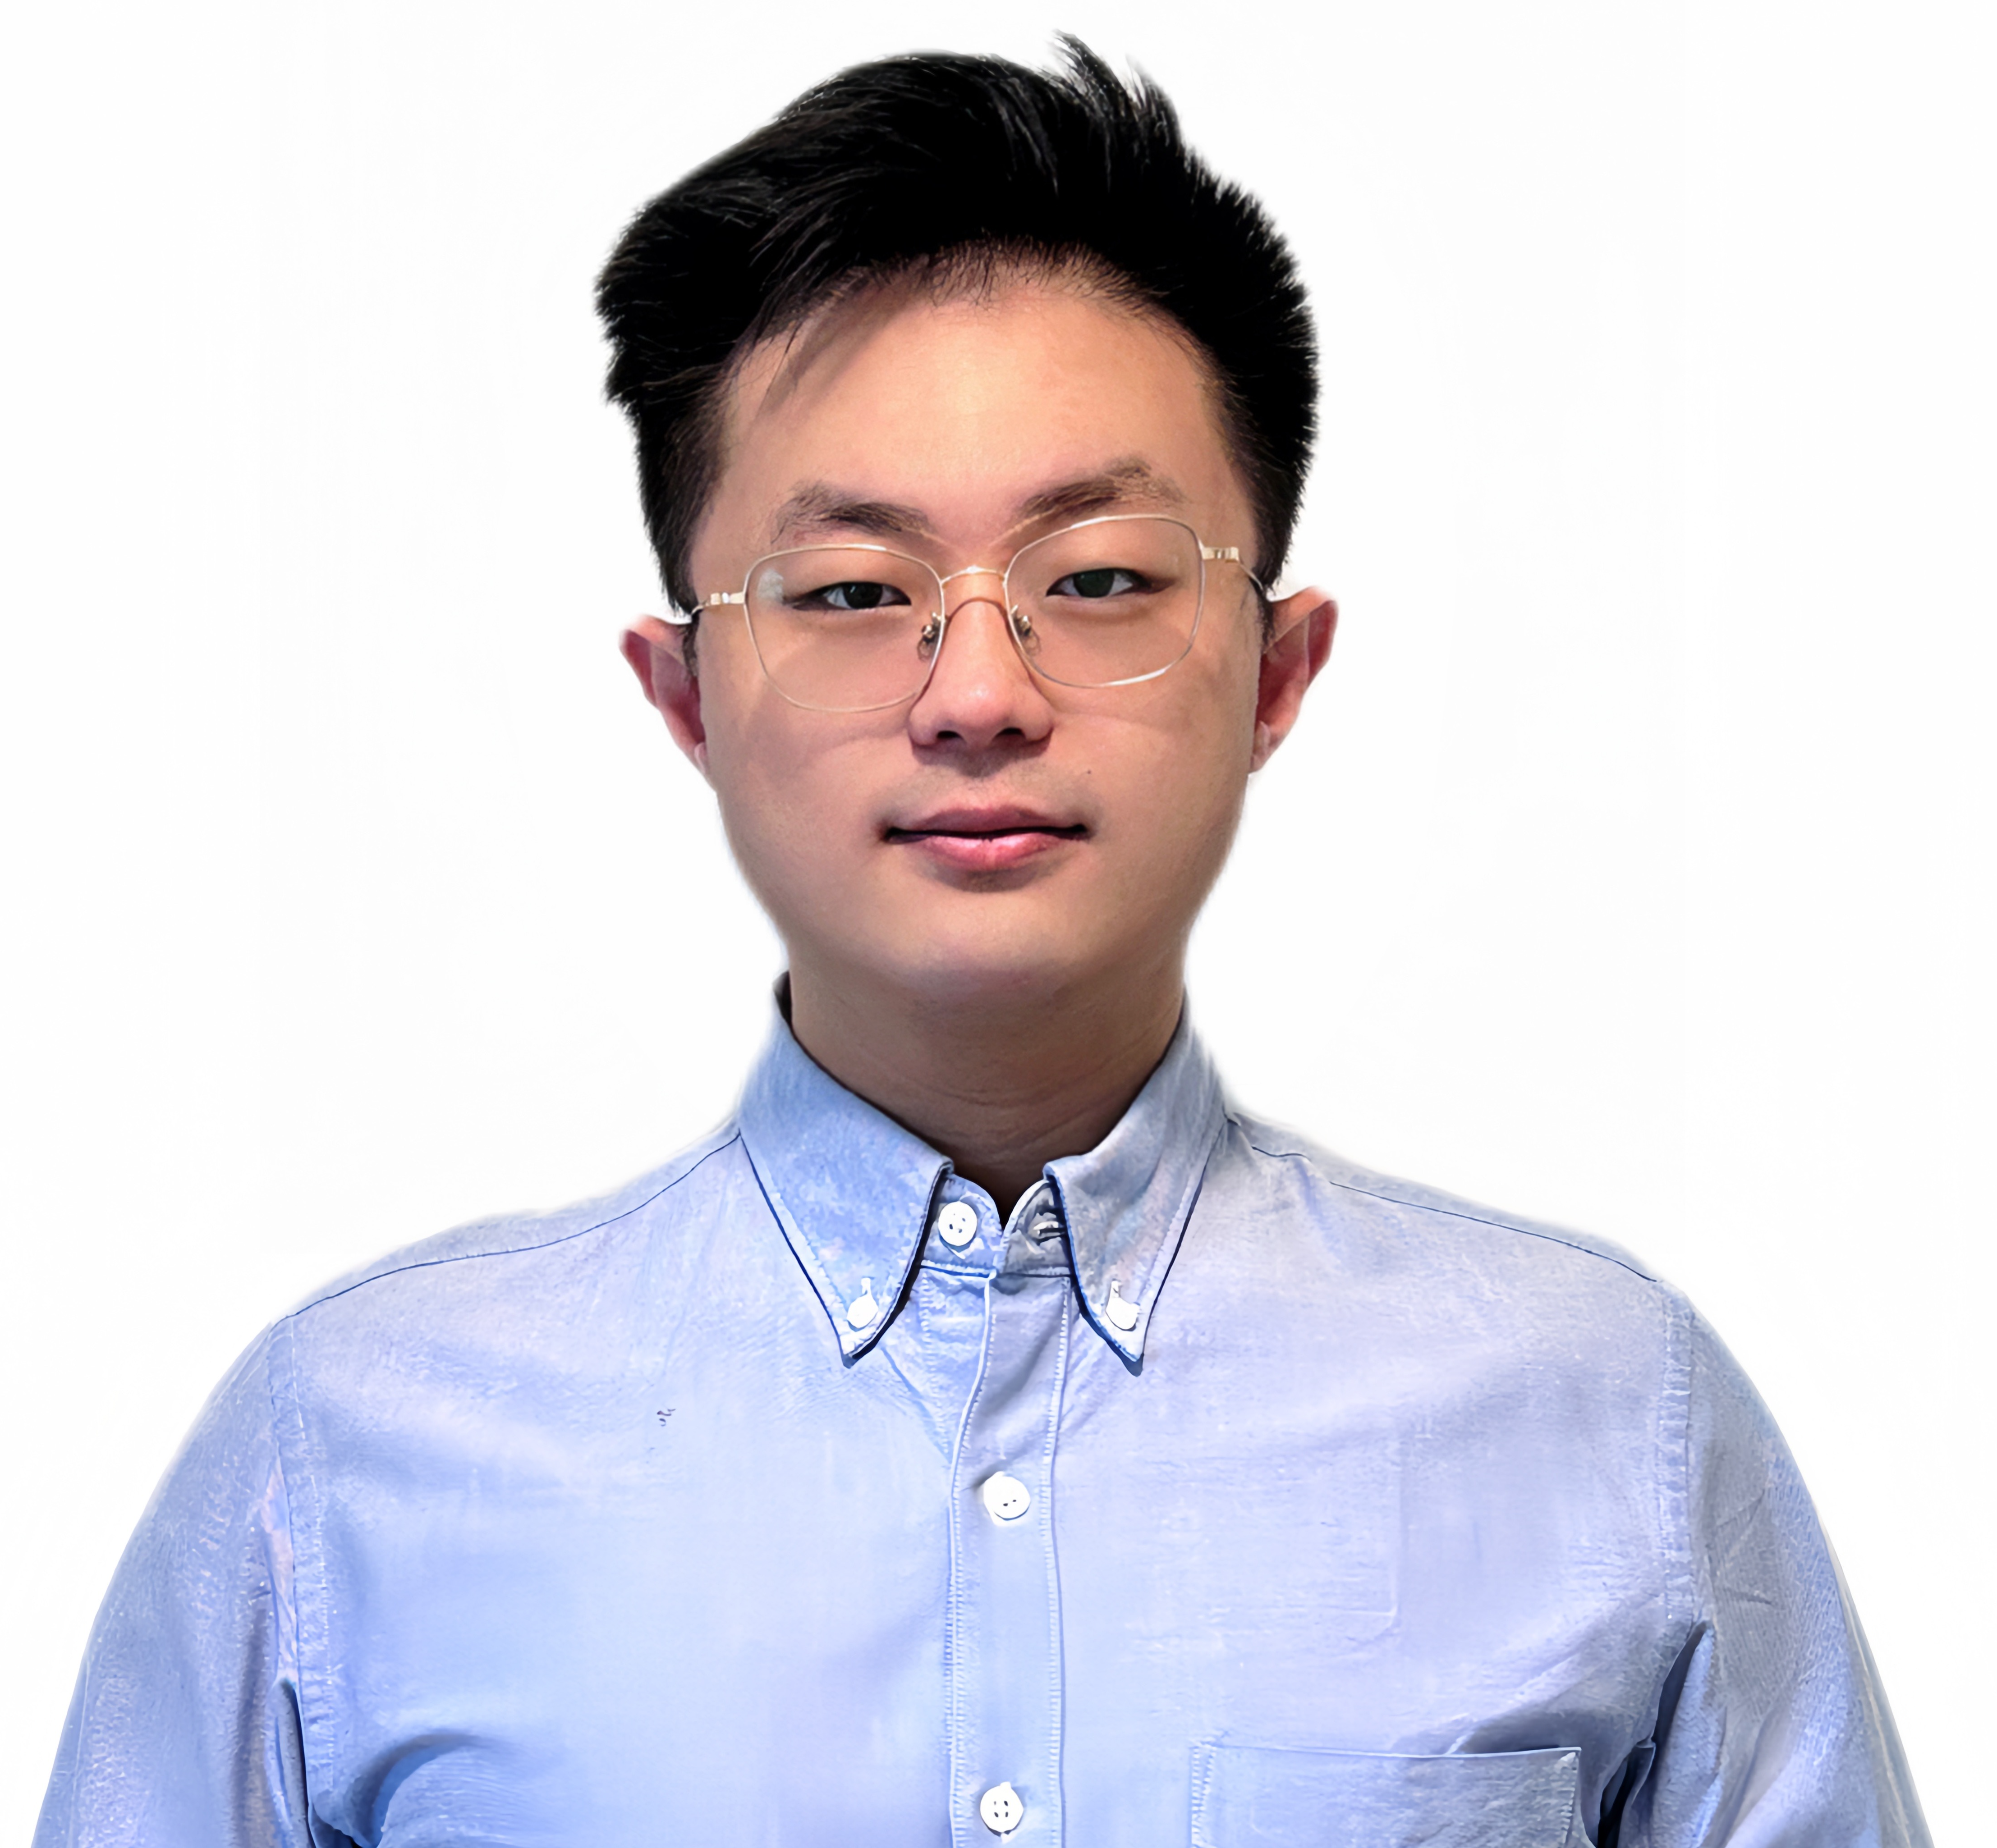
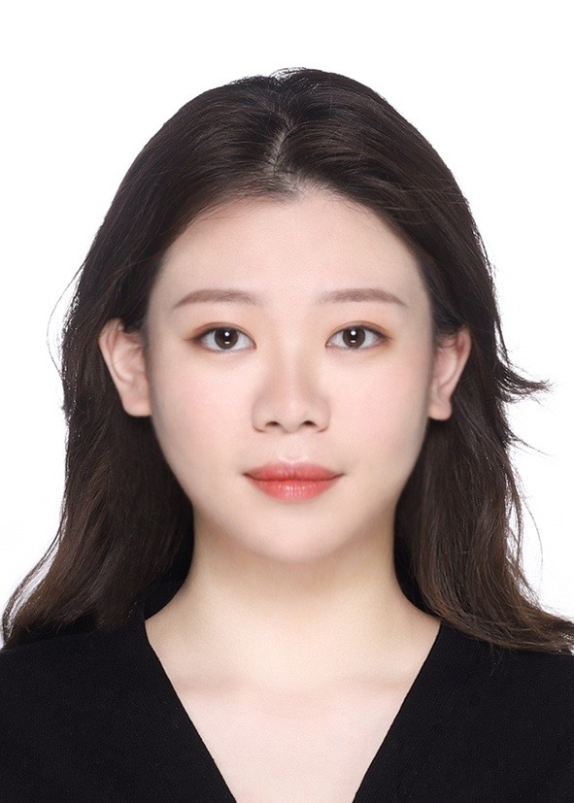
Our Coordinators
Felix Amanor Otu
Internship Contact Coordinator
Jahirul Islam
Record Keeping Coordinator
Nana Yaw Amoako-Fordwour
Initiative Placement Coordinator
Xuejing (Amy) Yue
Communication Coordinator
We are hiring!!
Please visit the MIAB website for more information
Liyuan (Geoffrey) Gu
Communication Coordinator
Wenxuan (Wade) Wei
Initiative Placement Coordinator
Ying (Chloe) Liu
Employer Contact Coordinator
Vacant
NPO Employment Strategy Coordinator

Slide 16
Job Responsibility In Working Groups
Internship Working Group
Attend weekly meetings and review a predetermine agenda
Alternate chairing and minute taking
Provide a platform to linked students, employers and interns
Assist students in the internship process, course registration, co-op permit application for international students,
Provide information on professional associations and qualifications
Manage MIABEMPL & MIABSTUD & MIABINT email accounts
Assist in presentation coordination and meetings
MIAB HR– miabhr@yorku.ca
Job responsibility in working groups:
Notes:
Sana will prepare by Mon17Jan22
Reviewed by IntWG on Mon17Jan22
Reviewed by IntAdvWG Sat22Jan22

Slide 17
Job Responsibility In Working Groups
Alumni & Mentoring Working Groups
@miabalum & @miabment:
Attend all the meetings weekly, chair and take the minutes of the meetings
Manage MIABALUM & MIABMENT email accounts
Monitoring of all MIAB working groups activities
Report details of the latest work process of Alumni Liaison & Mentoring working group
Oversight MIAB website (Alumni and Mentoring)
Prepare the mentoring related content and provide in student newsletters
MIAB HR – miabhr@yorku.ca
Notes:
Reviewed by IntWG Wed22Dec21
Reviewed by IntAdwg Sat8Jan22

Slide 18
Branding and Communication Working Group (@miabuni) :
BCWG is mainly responsible for the operation of the MIAB website, social media and communications.
Careers Development Working Group (@miabenrl) :
Prepare and develop monthly Career Skills Sessions
Organize the Career Skills Sessions Survey
Contact with alumni and Career Center to develop Career Skills Sessions.
Inform alumni that we are providing Career Skills Sessions for them and current students.
Job Responsibility In Working Groups

Slide 19
Alumni Liaison & Mentoring Working Group (@miabment):
Attend all the meetings as chair or minute taker.
Maintain a solid arrangement of administration the Mentoring Program
Alumni Board (@miabalum):
Attend the Alumni Board meetings and take the minutes.
Prepare the Alumni and mentoring-related news content and provide it in the Alumni Newsletters.
LinkedIn SubCommittee (members):
Prepare LinkedIn Job Posting report weekly
Prepare the mentoring related content and provide it in the LinkedIn newsletter and, also our LinkedIn bulletin.
Find the MFAc alumni on LinkedIn and invite them to join the mentoring program, career skills sessions and MIAB governance
MIAB HR – miabhr@yorku.ca
Job Responsibility In Working Groups

Slide 20
For further information, please email to
miabhr@yorku.ca

Slide 21
Introduction to FACC 6850 -​ Professor Tony Stanco​
Co teaches with Professor Paul Evans​

Slide 22
FACC 6850
Unique Features
Full course - is equivalent to two elective courses
Can fill all elective requirements if you wish
Often spans more than one term
Can start at any time during a term
Can include more than one practicum
Not necessary to be in Toronto
Co-op permit normally required, but not for MIAB internships
FACC6000 prerequisite should be taken in the first term

Slide 23
FACC 6850
The Course
10 class participations including 5 presentations
Classes are scheduled so that everyone can fulfill the attendance requirement; no need to attend every class
Career Skill Sessions attendances count for 1/3 up to 2 of the 10 required
Preliminary Project Presentation
2 Interim Report presentations
2 Final Report presentations
Reports and presentations form bulk of grade
Employer provides some grade input
Peer evaluations are required and shared
Class participation is also graded
Classes and practicums may be remote or in person (including from outside Toronto)

Slide 24
FACC 6850
The Practicum
Students are responsible for finding their own internships (with assistance from MIAB)
Must be at least 10 weeks
Minimum 300 hours for full-time students
Maximum 16 months for one or more internships
May be paid or unpaid
Any employment likely qualifies
Request approval from pevans@yorku.ca using form 2Z
Employer must be approved before hours can count
Health and Safety Questionnaire must be completed before hours start to count

Slide 25
FACC 6850
Enrollment Process
Enroll as soon as possible in the FACC 6850 Pre-Registration Orbis Platform (FACC6850 PROP)
It is the student’s responsibility to locate an appropriate placement
MIAB will help you find an appropriate employer
Pre-requisite: GS/FACC6000 3.00 Introduction to Governance and Accountability (a few MIAB first internships can start earlier)
Pre- or Co- requisite: GS/FACC6100 3.00 Corporate Responsibility and Ethics

Slide 26
FACC 6850
Enrol in FACC6850 PROP
There is no cost or obligation. Best is simply sign up and then view the information which is provided there
You will be required to complete a survey and upload your documents relevant to finding an internship
Simply email miabstud@yorku.ca or pevans@yorku.ca to sign up for FACC6850 PROP
You can sign up for FACC6850 PROP anytime, please do so as soon as possible
After completing FACC6850 PROP enrollment remember to start applying as soon as possible (some competitive internship positions for next summer close mid-September)

Slide 27
FACC 6850
International Students
Important to apply for a co-op permit as soon as possible even if you do a MIAB internship which does not require it
Requires IRCC letter from MFAc Program with application (MIAB will arrange letter for you)
IRCC usually takes 1-4 months (recently 120 days)
MIAB internships can commence without the permit
MIAB had a great York International presentation on IRCC requirements on Friday, January 5 at 11:30am as part of MO22 (see website for powerpoints)

Slide 28
MIAB Website
Communication Coordinator, Xuejing (Amy) Yue

Slide 29
Roles in MIAB Communication Coordinator
Attending A&C, B&C, LISC, and HR meetings, chairing or taking minutes as scheduled, and work progress reporting
Reviewing and updating website regularly
Creating contents for and posting MIAB events, news, recruitment advertisements on LinkedIn
Developing marketing strategies and implementing
Preparing Student Newsletter monthly, LinkedIn Newsletter before each term, website usage report monthly
Ensuring internal and external communication going smoothly
Planning for succession and training new coordinators
A&C and C&A Coordinator

Slide 30
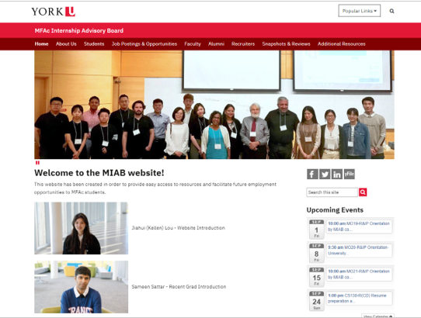
MIAB Website
MIAB Website at York University:
The BEST place for those interested in internships to stay tuned for any updates within the program. ​
https://miab.info.yorku.ca/, we will keep improving our website and welcome any suggestions from you! ​
Notes:
Reviewed by IntAdvWG Sat22Jan22
Reviewed by IntWG Mon24Jan22

Slide 31
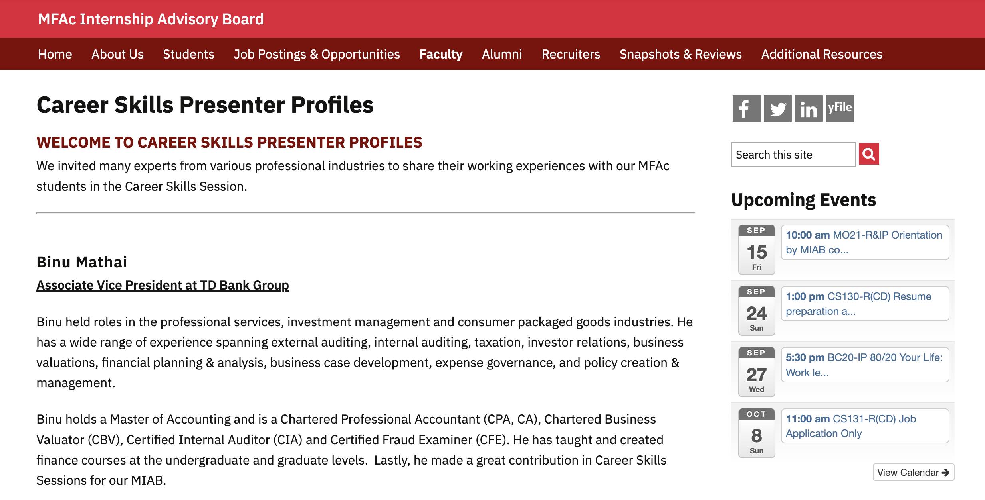
MIAB Website
Career Skills Sessions Scheduled for Winter term
Notes:
Reviewed by IntAdvWG Sat22Jan22
Reviewed by IntWG Mon24Jan22

Slide 32
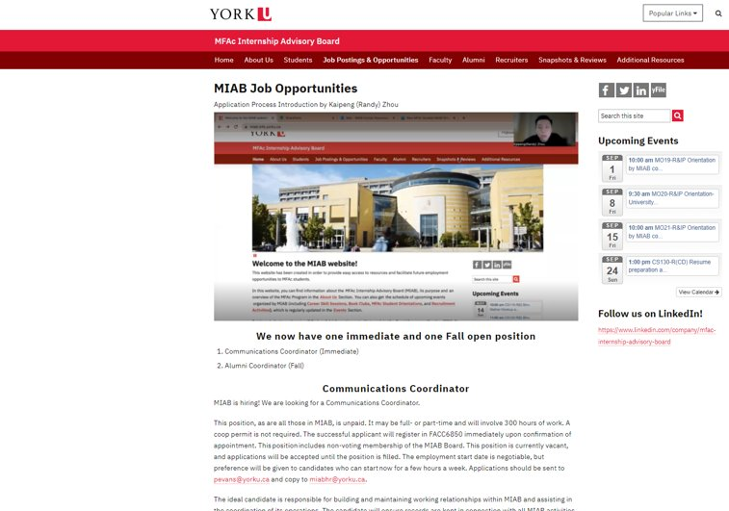
MIAB Website
Employment Information
Notes:
Reviewed by IntAdvWG Sat22Jan22
Reviewed by IntWG Mon24Jan22

Slide 33
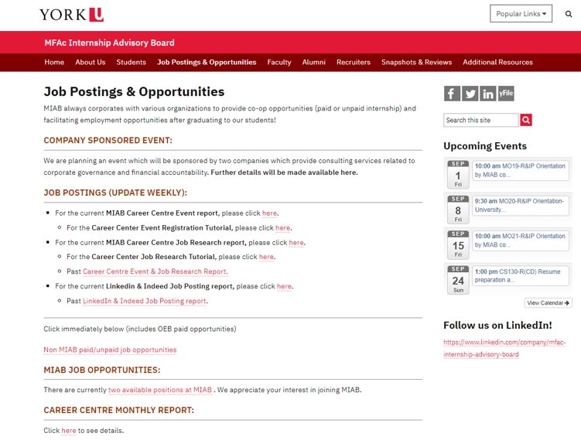
MIAB Website
Internship
Job Opportunities
Notes:
Reviewed by IntAdvWG Sat22Jan22
Reviewed by IntWG Mon24Jan22

Slide 34
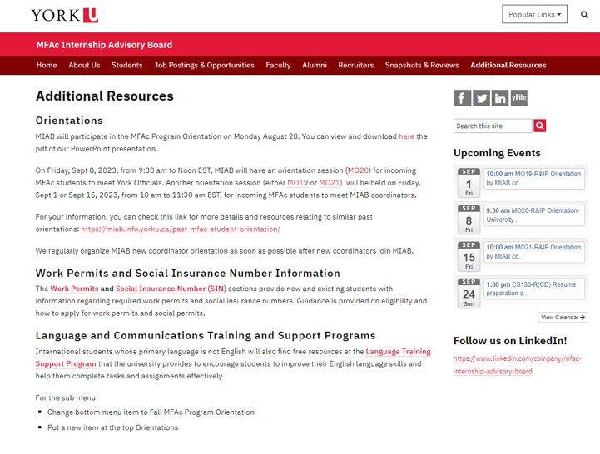
MIAB Website
Additional University Resources
Notes:
Reviewed by IntAdvWG Sat22Jan22
Reviewed by IntWG Mon24Jan22

Slide 35
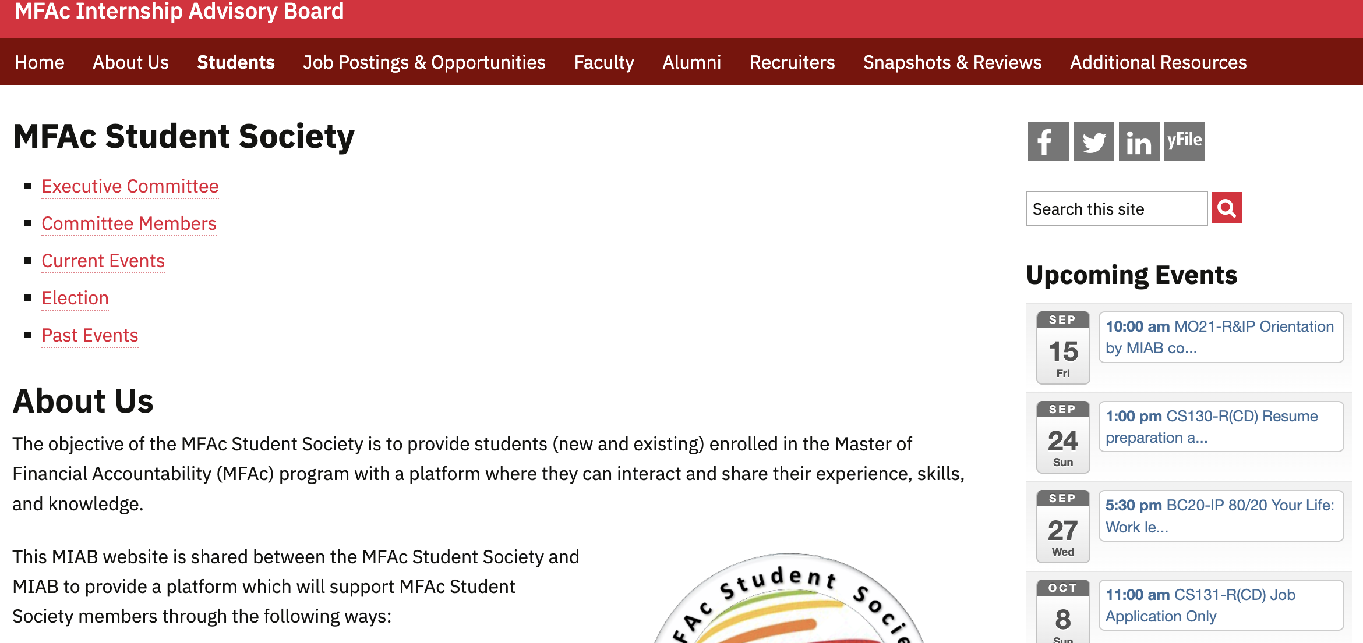
MIAB Website
MFAc Student Society
Notes:
Reviewed by IntAdvWG Sat22Jan22
Reviewed by IntWG Mon24Jan22

Slide 36
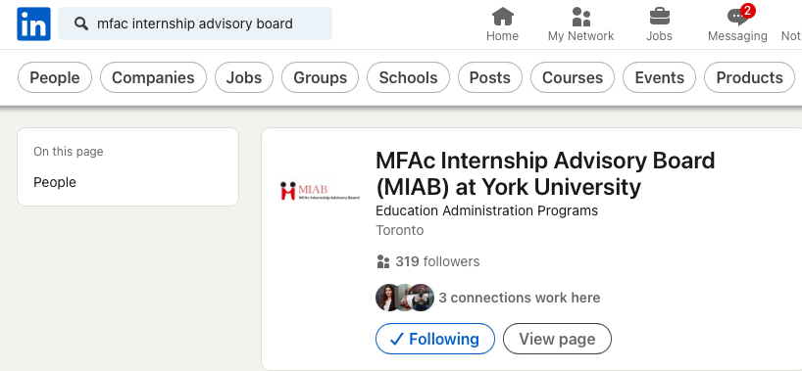
Communication Channels
MIAB LinkedIn
Follow us on LinkedIn for connection and networking
https://www.linkedin.com/company/mfac-internship-advisory-board
Student Newsletter
Monthly publish thru mfagpa email and website
https://miab.info.yorku.ca/student-newsletter-2/

Slide 37
For further information, please email to
miabuni@yorku.ca

Slide 38
Career Skill Sessions
Session Coordinator, Yuxi (John) Lin

Slide 39
Roles in MIAB Session Coordinator
Develop and execute networking and career skills, and orientation events.
Help students register for each event and maintain attendance records for all events.
Responsible for communications with students and presenters.
Create survey for each event and collect the feedback from students
Prepare career skill certificate for students who required.
Arrange for payment of presenters and financial transactions associated with events.
Career Session Coordinator

Slide 40
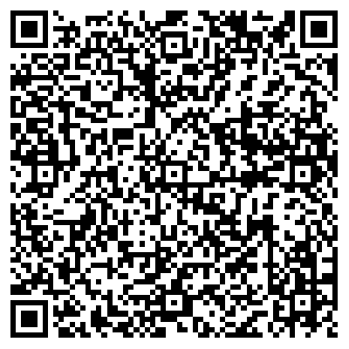
Registration
MIAB home page → Students → MIAB events → Registration Form
Sign up NOW!!!
To participate, please register by clicking on Registration.
Share the registration link with your classmates!

Slide 41
2024 Winter Career Skill Sessions
Session | Topics | Date | Time
CS135-R | Sameen Sattar: How to get your dream job in Canada (Part1) | Sunday, January 28, 2024 | 10am-11:30am
CS136-R | Sameen Sattar: How to get your dream job in Canada (Part2) | Sunday, February 4, 2024 | 10am-11:30am
CS137-R | Zahid Islam-Resume Preparation | Sunday, February 25, 2024 | 10:30am-12pm
CSW241 | Excel basics-navigating through Excel | Saturday, March 2, 2024 | 1pm-2pm
CSW242 | Excel basics-core functions | Saturday, March 2, 2024 | 2pm-3pm
Notes:
Reviewed by IntWG Mon24Jan22

Slide 42
Career Skills Confirmation
Get your skills certified!!
How to apply?
Email your request to miabenrl@yorku.ca upon completion of the requisite hours
For more details, please refer to the MIAB website at https://miab.info.yorku.ca/career-skills-sessions/

Slide 43
Winter 2024 Financial Modeling (FMW)
This program is for students and alumni who are interested in developing their financial modeling skills. All these classes cover from fundamental to advanced levels.
Session | Topics | Date | Time
FMW2411/2412/2413 | Overview + Foundational technical skills, Model design and reflection questions, Revenues | Saturday, March 9, 2024 | 1pm-4pm
FMW2421/2422/2423 | Recap Day 1 + Costs, Financial statements, Depreciation | Saturday, March 16, 2024 | 1pm-4pm
FMW2431/2432/2433 | Recap Day 2 + Income Taxes, Working capital, Debt and equity + Other considerations + Recap all 3 days, exercises, Wrap-up | Saturday, March 23, 2024 | 1pm-4pm
Summer: Power BI Program (PBIP)

Slide 44
Book Club
Session | Topics | Date | Time
BC23-IP | Who says Elephants Can't Dance Inside IBM's Historic Turnaround, Louis Gerstner Jr., 2002 | Thursday, January 25, 2024 | 5:30pm-8pm
BC24-IP | Elon Musk, Tesla, SpaceX, and the Quest for a Fantastic Future, Alan Vance, 2015 | Thursday, March 7, 2024 | 5:30pm-8pm
BC25-IP | Elon Musk by Walter Isaacson, 2023 | Thursday, May 9, 2024 | 5:30pm-8pm
Notes:
Reviewed by IntWG Mon24Jan22

Slide 45
Student Interface
Zixuan (Krystal) Wang

Slide 46
Roles in MIAB Student Interface – Krystal
Assisting students who are interested in FACC 6850 to register for the FACC 6850 Pre-registration Orbis Platform (PROP) and FACC 6850 Practicum Course;
According to the student information and documents provided to understand students’ intentions and provide better services;
Helping MFAc students to request IRCC letters that students can apply for Co-op Work Permit.
For more information about Co-op Work Permit and Post Graduate Work Permit, please visit the MIAB website through this link: https://miab.info.yorku.ca/work-permits/
Notes:
Reviewed by IntWG Wed22Dec21
Reviewed by IntAdwg Sat8Jan22

Slide 47
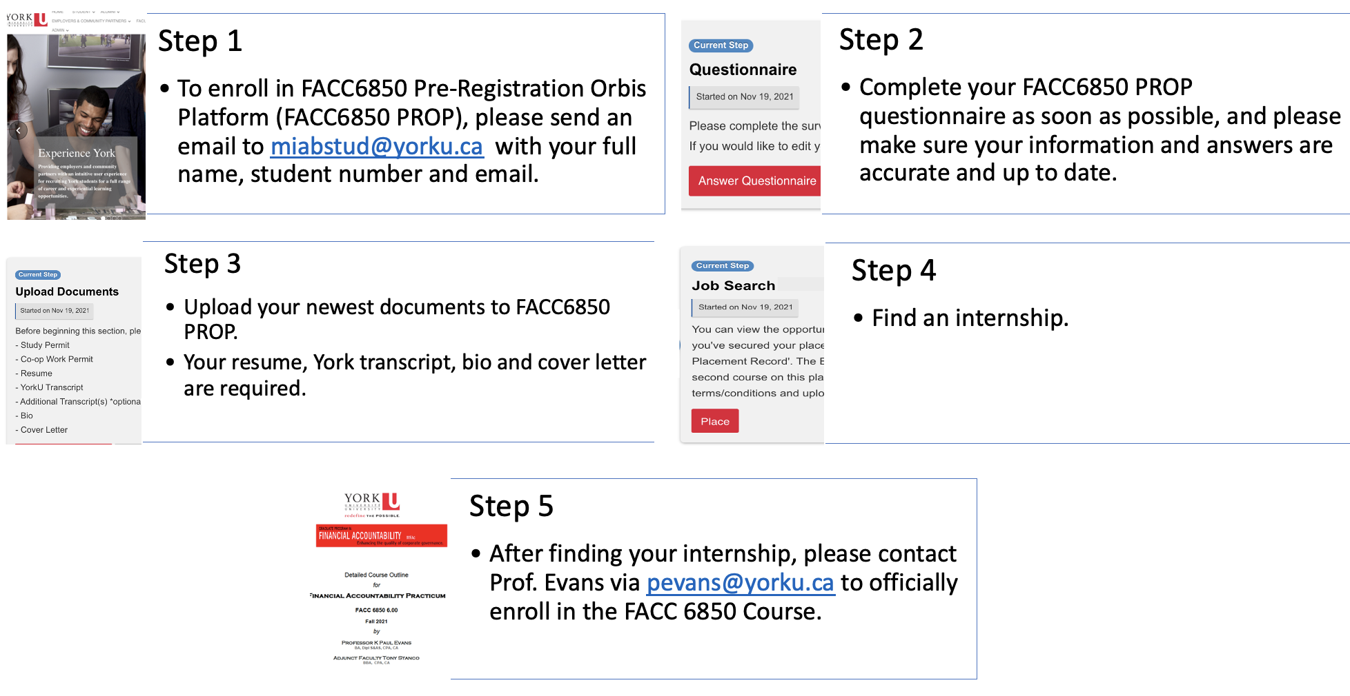
FACC 6850 Pre-registration Orbis Platform (PROP)
For more information about FACC6850 PROP, please visit the MIAB website via this link: https://miab.info.yorku.ca/orbis-system-instruction/
Notes:
Reviewed by IntWG Wed22Dec21
Reviewed by IntAdwg Sat8Jan22

Slide 48
FACC 6850 Practicum Course - Introduction to Accountability & Governance
FACC6850 is a practicum course that counts for 6.0 credits. Also, you can use it for your entire electives or in addition.
FACC 6850 Practicum Course provides students an opportunity to work in a financial accountability related position. The placement allows students to observe professionals at work and will give them the opportunity to apply their theoretical knowledge to live situations or projects.
Prerequisites
FACC 6000 – Introduction to Accountability & Governance
You can only apply for the FACC6850 course if you have a job.
For more information about the FACC6850 course, please visit the MIAB website via this link: https://miab.info.yorku.ca/what-happens-once-they-are-enrolled-in-facc-6850/
Notes:
Reviewed by IntWG Wed22Dec21
Reviewed by IntAdwg Sat8Jan22

Slide 49
Employer Interface
Chunhao (Kris) Jiang

Slide 50
Help students to find suitable internships.
Together with the Student Contact Coordinator we are responsible for tracking students and employment opportunities.
Follow up with the people who are doing internships.
Find out about potential future internship opportunities.
We solidify our relationships with employers by recommending the appropriate students and then providing good feedback from the employers.
Search for employer events and career center employment opportunities and make our students aware of them.
MIAB has connections with many not-for-profit organizations that can help you improve your chances of finding internships in this kind of organization.
Maibempl@yorku.ca
Roles in MIAB
Employer Contact Coordinator
Notes:
Reviewed by IntWG Wed22Dec21
Reviewed by IntAdwg Sat8Jan22

Slide 51
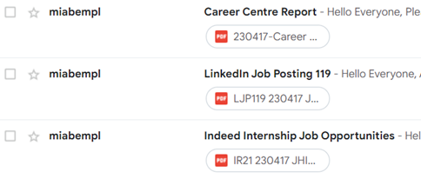
Job Postings https://miab.info.yorku.ca/media/

Slide 52
Internship Contact Coordinator
Felix Amanor Otu

Slide 53
Assist with finding internships for past coordinators/interns who are interested in further internships
Work with current students to identify their areas/industry interest to provide opportunities for internship/employment opportunities
Work closely with colleague coordinators to respond to student enquiries and onboarding into FACC 6850
Assist with providing/directing students to helpful resources to facilitate their internship placement
Help provide answers to students who have questions on the MIAB program
Roles in MIAB
Internship Contact Coordinator

Slide 54
After joining the FACC 6850
FACC 6850
External
MIAB
MIAB
Transfer
External
300 hours in total
Notes:
Reviewed by IntWG Wed22Dec21
Reviewed by IntAdwg Sat8Jan22

Slide 55
Contact
If interested in MIAB Internship, kindly send an email to
Miabint@yorku.ca
Miabhr@yorku.ca
Miabempl@yorku.ca

Slide 56
Alumni and Mentoring Coordinator
Mark Gyamfi

Slide 57
Managing MIAB Mentoring Program.
Matching mentors and mentees.
Developing potential mentees and mentors.
After the mentor accepts the mentee and vice versa, send both mentee and mentor the MIAB - Confidentiality Agreement and request to sign.
Then the mentoring session can start.
Following the mentoring progress.
Miabment@yorku.ca
Roles in MIAB
Alumni & Mentoring Coordinator
Link: https://miab.info.yorku.ca/career-mentor-program-2/
Notes:
Reviewed by IntWG Wed22Dec21
Reviewed by IntAdwg Sat8Jan22

Slide 58
Alumni Activities
Networking Event
Plan for this term: in-person event.
Benefits: Opportunity to network and exchange work experiences for MFAc students and alumni
Goals: Increase MFAc student employment opportunities. Help students practice what they have learned in class.
If you are interested in this, please reach out to our coordinator (miabalum@yorku.ca) for more information.

Slide 59
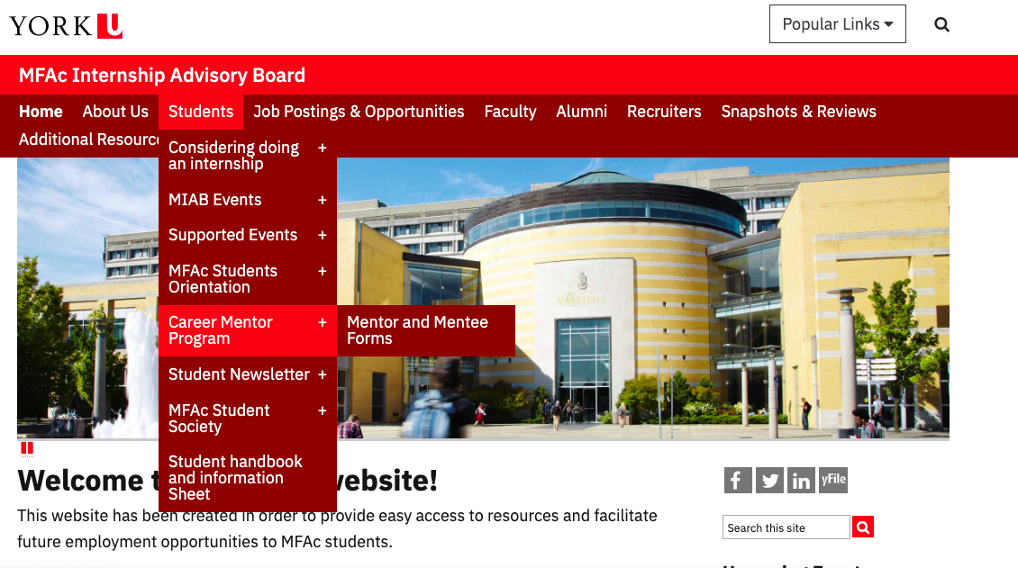
Sign up for Mentorship!

Slide 60
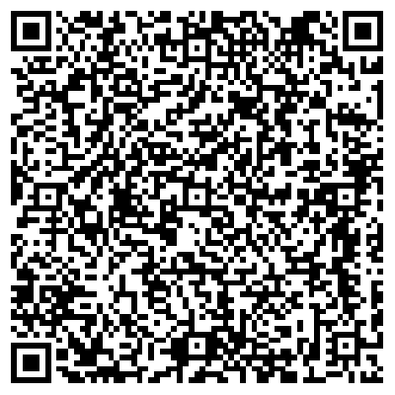
Thank you for listening!
Please fill out the survey.

