Slide 1
MIAB Orientation Event - MO22
Friday, Jan 5, 2024, at 9:30am – 12:00pm
（Co - Chairs: Yuxi (John) Lin and Professor Tony Stanco）

Slide 2
Introduction
Professor Tony

Slide 3
MIAB MFAc Orientation Networking Event - MO22
Friday Jan 5, 2024 9:30 - noon
（Co-Chairs: Yuxi (John) Lin and Professor Tony Stanco)
Presentation | Event Schedule
Introduction (Professor Tony Stanco) | 10mins, 9:30-9:40
1. MFAc Office: Sabina Passarelli, Graduate Program Assistant | 15 mins, 9:40-9:55
2. Accessing Information (Panel) | 25 mins, 9:55-10:20
Communication Skills introduction by Jon Sufrin, Career Centre introduction by Susan Pogue, Introduced by Amy Yue, Communications Coordinators
3. York Libraries: Angie Liann, Teaching & Learning Librarian / Business Librarian, Introduced by Kris Jiang | 20 mins, 10:20-10:40
Break | 15 mins, 10:40-10:55
4. Internship Office: Dammy – Research Assistant in Internship Working Group, Introduced by Sonanshi Patel, Internship Contact Coordinator | 20 mins, 10:55-11:15
5. Student Society/Graduate Student Association presentation: Feiyu Chen, Introduced by Dammy, Research Assistant & MFAc Student Society Treasurer. | 15 mins, 11:15-11:30
6. York International: International Student Advisors & Immigration Specialist Vivian Wang, Introduced by Sonanshi Patel (Internship Contact Coordinator) | 30 mins, 11:30-12:00
Survey | 5mins
https://forms.office.com/Pages/ResponsePage.aspx?id=GBNTNBFw1E-H8KQ4FsSb0AwXCdeYx8BBvRh_mN8Zw8lURFNGU1lGRVpMRE9HOE41TkZHN0hZWTZDVi4u

Slide 4
MFAc Office
Sabina Passarelli Graduate Program Assistant

Slide 5
Career Center introduction
Susan Pogue

Slide 6
York Libraries
Angie Liann Teaching & Learning Librarian / Business Librarian

Slide 7
Communication Skills Introduction
Jon Sufrin

Slide 8
Break

Slide 9
Internship Office
Dammy

Slide 10
Student Society/Graduate Student Association
Feiyu Chen
President

Slide 11
MFAc Student Society
Objectives
Provide students with a platform where they can interact and share their experience, skills, and knowledge.
Opportunities
Build network
Enhance interpersonal skills
Workshops, Events, and Panel Discussions

Slide 12
Elections
Vice-President
Treasury
Secretary
Marketing Officer

Slide 13
Elections Requirement
Prepare a personal statement indicate:
Personal background
Preferred position
max of 250 words
Sent it to the returning officer Tony Stanco at stancotony@gmail.com
For detailed job description, please visit our website https://miab.info.yorku.ca/mfac-student-society-election/

Slide 14
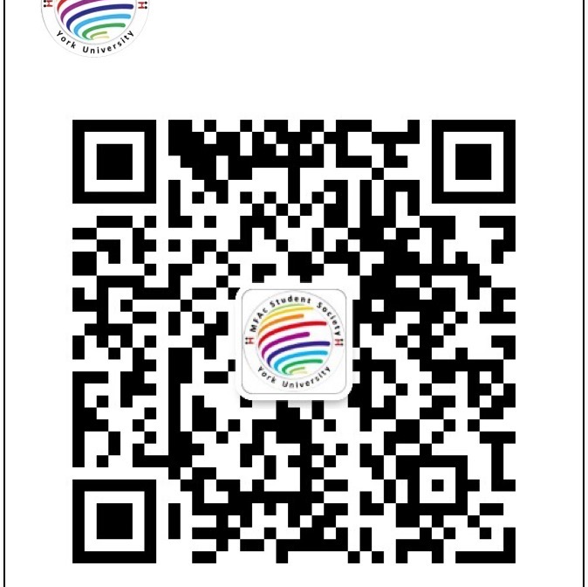
Connect
For our current MFAc students' connections, we have:
WhatsApp
WeChat
Meanwhile, For any general enquires or concerns, please contact us via group chats or email.
Please send us an email to miabss@yorku.ca for joining.

Slide 15
York International
Samantha Yan International Student Advisors & Immigration Specialist

Slide 16
MFAc Internship Advisory Board
Professor Paul Evans FACC6850 CO-COURSE DIRECTOR

Slide 17
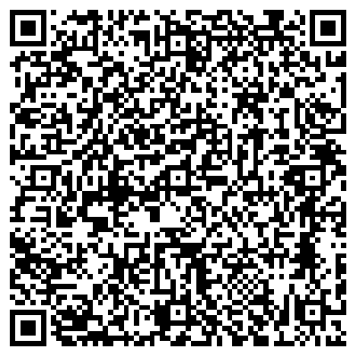
Thank you for listening.
Please fill out the survey.

