Slide 1
MIAB Orientation Networking Event - MO17
Sunday, May 7, 2023, at 10:00- 11:30 am
（Co - Chairs: Kunyuan (Ashley) Chen and Professor Tony Stanco）

Slide 2
MIAB MFAc Orientation Networking Event - MO17
Sunday, May 7th, 2023 10:00am – 11:30am (approx)
（Co - Chairs: Kunyuan (Ashley) Chen and Professor Tony Stanco）
Presentation | Event Schedule
 | Approximate
Welcome – Professor Tony Stanco (co-chair of event) | 3 mins, 10:05-10:08
1. Introduction to MIAB - Professor Tony Stanco | 7 mins, 10:08-10:15
2. Structure of MIAB – Kaipeng (Randy) Zhou | 7 mins, 10:15-10:22
3. Introduction to FACC6850 - Professor Tony Stanco | 10 mins, 10:22-10:32
4. MIAB Website –Jiahui (Kellen) Lou | 10 mins, 10:32-10:42
5. Career Skills Sessions - Kunyuan (Ashley) Chen | 7 mins, 10:42-10:49
Break | 10 mins, 10:49-10:59
6. Student Interface – Hao (Alexendra) Zheng | 7 mins, 10:59-11:06
7. Employer Interface - Haowen (Irene) Liu | 7 mins, 11:06-11:13
8. Intern and Adviser Placement Coordinator - Lu Zhang | 7 mins, 11:13-11:20
9. Mentoring – Han Xu, Alumni and Mentoring Coordinator | 7 mins, 11:20-11:27
10. Completion of survey – Kunyuan (Ashley) Chen | 3mins, 11:27-11:30

Slide 3
Welcome & Introduction to MIAB
Professor Tony Stanco

Slide 4
The Master of Financial Accountability Internship Advisory Board (MIAB) is a not-for-profit organization that was created in August 2019 to facilitate MFAc Students' success by providing more employment opportunities (co-op, internships and graduate jobs) and career skill development opportunities. The organization is run completely on a voluntary basis with the assistance of professors, students, MFAc alumni, employers and the York University administration.
Notes:
Reviewed by IntWG Wed22Dec21

Slide 5
Internships
Start seeking an internship as soon as you can
Coop permits usually required for international students
Consider a MIAB unpaid internship (no co-op permit)
FACC6850 PROP is here to help you
Read students section of MIAB site (especially Q&As)
300 hours minimum
You can do multiple internships
Notes:
Reviewed by IntWG Wed22Dec21

Slide 6
MIAB facilitates internships by:
Communicating with employers, alumni and students & facilitating contact between them
Maintaining an up-to-date website containing relevant information
Career skills program
Alumni mentoring program
Notes:
Reviewed by IntWG Wed22Dec21

Slide 7
Accounting Plus Financial Services*
Adopt4Life
All Nations International Development Agency
Corporate Knights (ranks companies' effectiveness in dealing with environmental issues)
Doctors for Doctors
et al. (start-up club/bistro for faculty and graduate students) (5)
SQL Power Group*
MFAc Internship Advisory Board
Ministry of Infrastructure (Government of Ontario)*
New Field International Education*
Open Text Corporation*
Power Career Education and Technology Inc. (Career coaching)*
Quality Online Education Group (International online educator)
Royal Bank of Canada*
Scotiabank*
Toronto Foundation
Toronto Renewable Energy Cooperative (specilizes in facilitating social financing)
VirgoCX (Blockchain and bitcoin facilitator)*
Warden Woods Community Centre
Notes:
Reviewed by IntWG Wed22Dec21

Slide 8
Angel Foundation
CCUE Finance
GoBest Immigration Consultants*
Hungry Panda Tech Ltd.
Toronto Hydro*
Bank of Montreal*
MIAB
Maison Brison*
Ontario Energy Board*
Open Text Corporation*
Unilever Canada*
CBRE*
HSBC*
PointA
New Matrixus Consulting
Global Smart Education Alliance*
Travelers* Liberty Utilities* Mackenzie Financial* MRKT360*
* Paid.
Notes:
Reviewed by IntWG Wed22Dec21

Slide 9
For further information email
miabstud@yorku.ca

Slide 10
Structure of MIAB
KaiPeng (Randy) Zhou

Slide 11
Human Resource Coordinator– MIAB HR
Be the main staff support and administer the work of the Human Resources Working Group (HRWG).
Review and make sure that our schedules of meeting times and significant future events are up to date and suitable for planning future MIAB activities.
Attend frequent meetings of the Internship Staff Working Group (IntWG) and the Administration and Communications Working Group.
Attend other working groups and boards as and when required or useful.
Update MIAB’s human resources records in collaboration with the MIAB Chair.
Ensure meeting reminders are sent, minutes are prepared and reviewed, and agendas are updated for all Working Group and Board meetings.
Serve as a backup to the other three other members of A&C as and when required.
Participate in recruitment, health and safety protocols, obligation agreements, employee relations, confidentiality agreements and other human resources tasks.
miabhr@yorku.ca
Notes:
Reviewed by IntAdvWG Sat22Jan22
Reviewed by IntWG Mon24Jan22

Slide 12
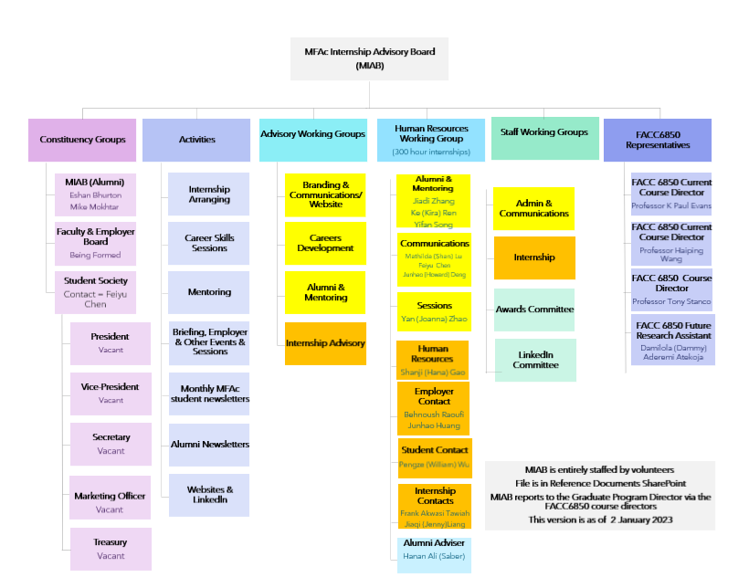
Structure of MIAB
Notes:
Reviewed by IntWG Mon24Jan22

Slide 13
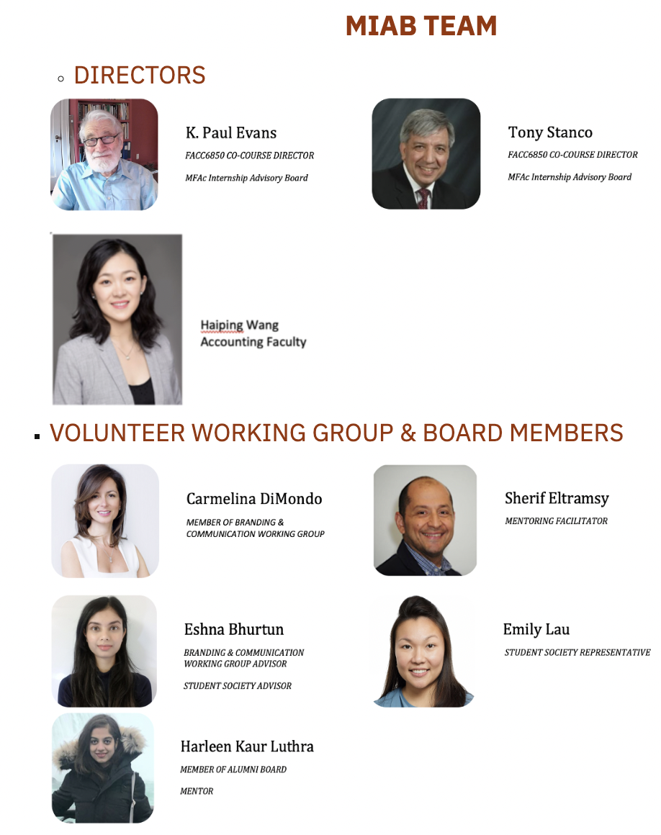
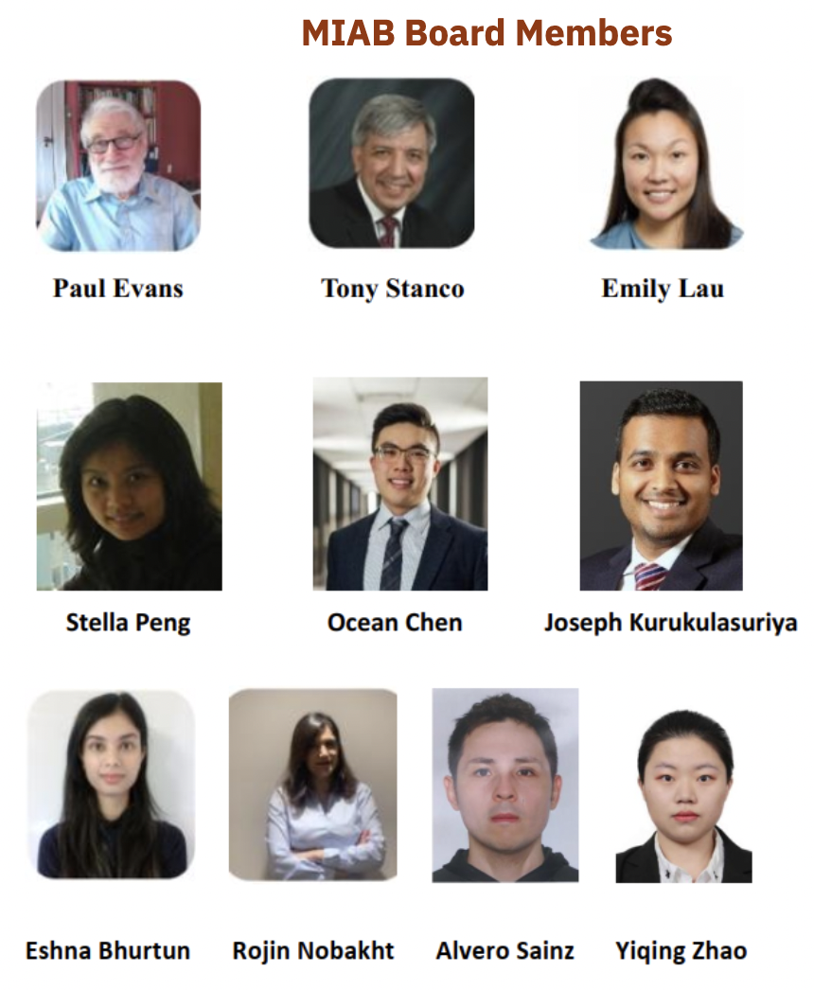
Notes:
Reviewed by IntWG Wed22Dec21

Slide 14
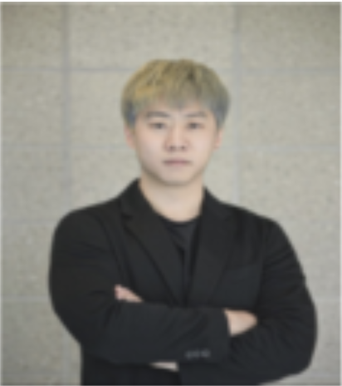
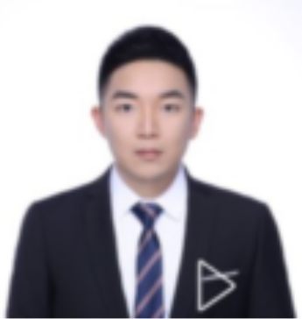
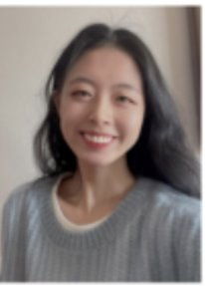
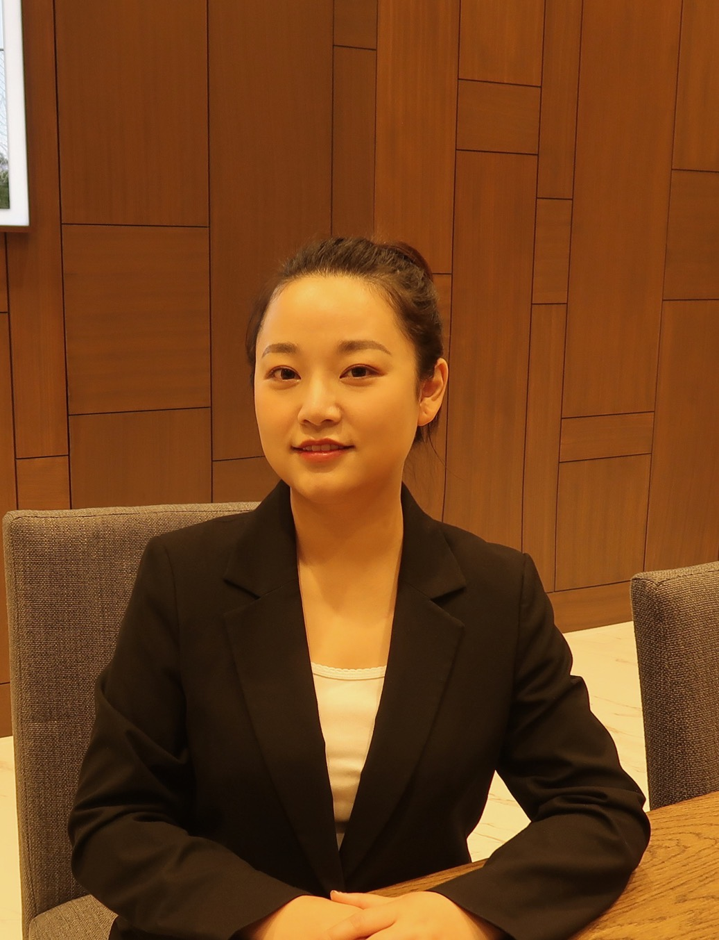
2023 Winter Coordinators
Pengze (William) Wu
Internship Contact Coordinator
Feiyu Chen
Communication and Administration Coordinator
Ren (Kira) Ke
Mentoring Coordinator
Yan (Joanna) Zhao
Sessions Coordinator
Yifan Song
Mentoring Coordinator
Jiadi Zhang
Alumni and Mentoring Coordinator
Shan (Mathilda) Lu
Administration and Communication Coordinator
Shanji (Hana) Gao
Human Resource Coordinator
Notes:
The image should be update (Reviewed by IntWG Wed22Dec21)
Chenxi will join in the MIAB around Jan 21, 2022 (Reviewed by IntWG Wed12Jan22)
Revise Sadie's name (Reviewed by IntWG Mon24Jan22)

Slide 15
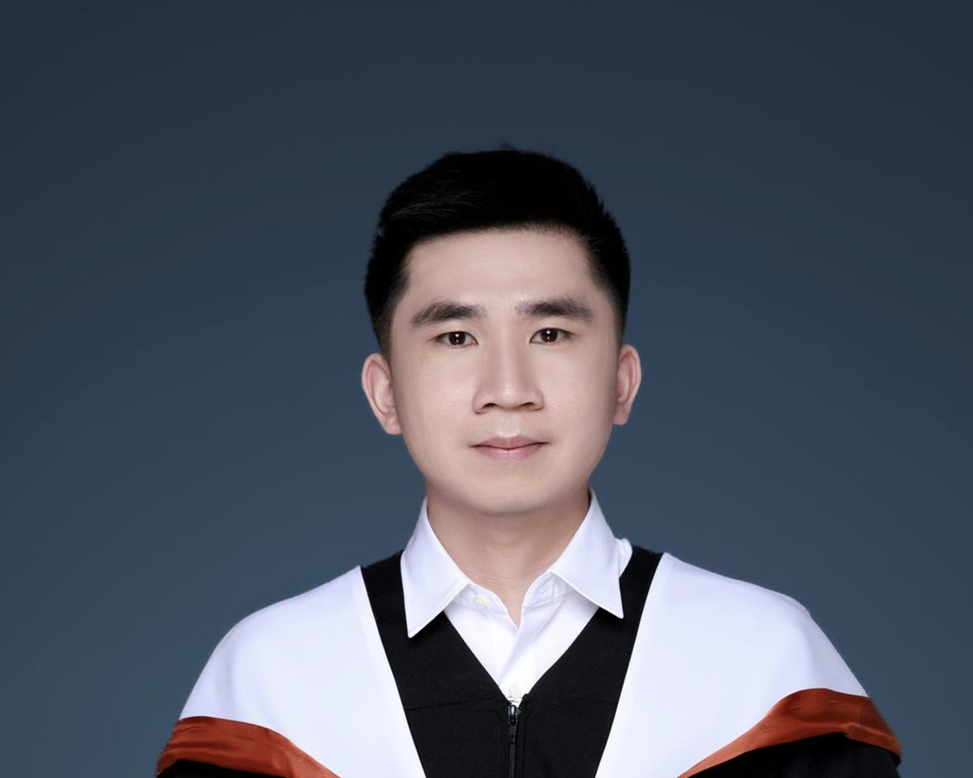
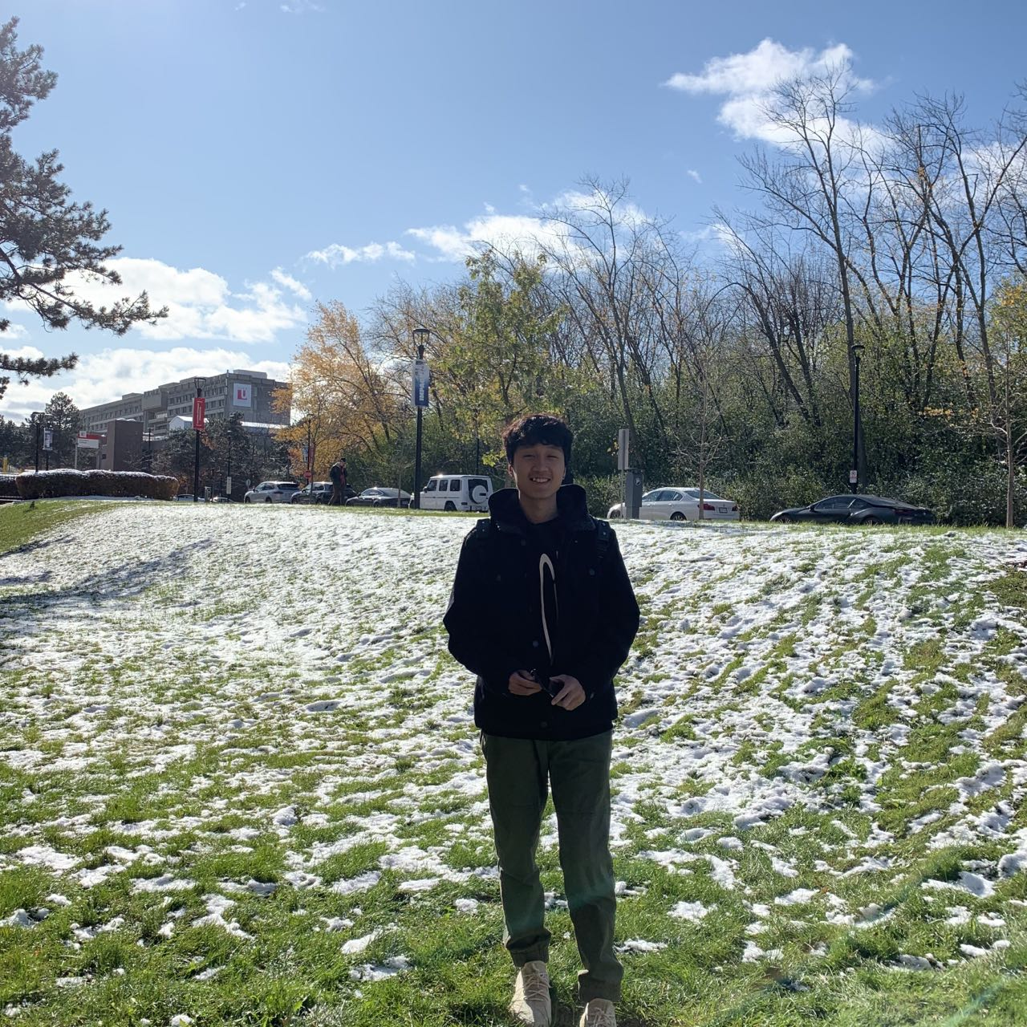
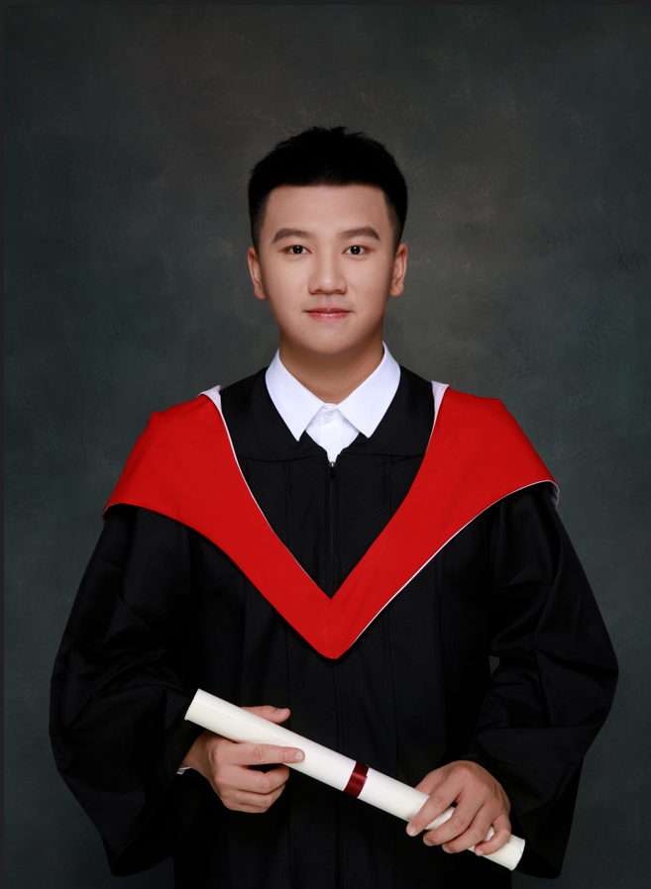
2023 Winter Coordinators
Junhao (Howard) Deng
Administration and Communication Coordinator
Junhao (Tracy) Huang
Employer Contact Coordinator
Ziyun (Joshua) Wang
Internship Contact Coordinator

Slide 16
Attend meeting three times a week and review a predetermine agenda
Provide a platform to linked students, employers and interns
Assist students in the internship process, course registration, co-op permit application for international students,
Provide information on professional associations and qualifications
Manage MIABEMPL& MIABSTUD email accounts
Assist in presentation coordination and meetings
Internship Working Group
MIAB HR– miabhr@yorku.ca
Job responsibility in working groups:
Notes:
Sana will prepare by Mon17Jan22
Reviewed by IntWG on Mon17Jan22
Reviewed by IntAdvWG Sat22Jan22

Slide 17
Job Responsibility in Working Groups
Administration and communication working group:
Attend all the meetings at least three times per week and chair the meeting frequently
Manage MIABALUM & MIABMENT email accounts
Monitoring of all MIAB working groups activities
Report details of the latest work process of Alumni Liaison & Mentoring working group
Oversight MIAB website (Alumni and Mentoring)
Prepare the mentoring related content and provide in student newsletters
MIAB HR – miabhr@yorku.ca
Notes:
Reviewed by IntWG Wed22Dec21
Reviewed by IntAdwg Sat8Jan22

Slide 18
JOB RESPONSIBILITY IN WORKING GROUPS
Branding and Communication :
BCWG is mainly responsible for the operation of the MIAB website, social media and communications.
Careers Development :
Prepare and develop monthly Career Skills Sessions
Organize the Career Skills Sessions Survey
Contact with alumni and Career Center to develop Career Skills Sessions.
Inform alumni that we are providing Career Skills Sessions for them and current students.
MIAB HR – miabhr@yorku.ca

Slide 19
Job Responsibility in Working Groups (Cont.)
Alumni Liaison & Mentoring:
•Attend all the meetings as chair or minute taker
•Maintain a solid arrangement of administration the Mentoring Program
Alumni Main Board:
•Attend the alumni MIAB Main Board meetings and take the minutes.
•Prepare the Alumni and mentoring-related news content and provide it in the Alumni Newsletters.
LinkedIn SubCommittee:
•prepare LinkedIn Job Posting report weekly
•prepare the mentoring related content and provide it in the LinkedIn newsletter and, also our LinkedIn bulletin.
Find the MFAc alumni on LinkedIn and invite them to join the mentoring program, career skills sessions and MIAB governance
MIAB HR – miabhr@yorku.ca
Notes:
Reviewed by IntWG Wed22Dec21
Reviewed by IntAdwg Sat8Jan22

Slide 20
For further information email
miabhr@yorku.ca

Slide 21
Introduction to FACC 6850 -
Professor Haiping Wang
Co teaches with Professor Paul Evans

Slide 22
MIAB Website
JIAHUI LOU

Slide 23
Job Description Jiahui(Kellen) Lou
Attending A&C, B&C, LISC, and HR meetings, chairing or taking minutes as scheduled, and work progress reporting
Reviewing and updating website regularly
Creating contents for and posting MIAB events, news, recruitment advertisements on LinkedIn
Developing marketing strategies and implementing
Preparing Student Newsletter monthly, LinkedIn Newsletter before each term, website usage report monthly
Ensuring internal and external communication going smoothly
Planning for succession and training new coordinators
A&C and C&A Coordinator

Slide 24
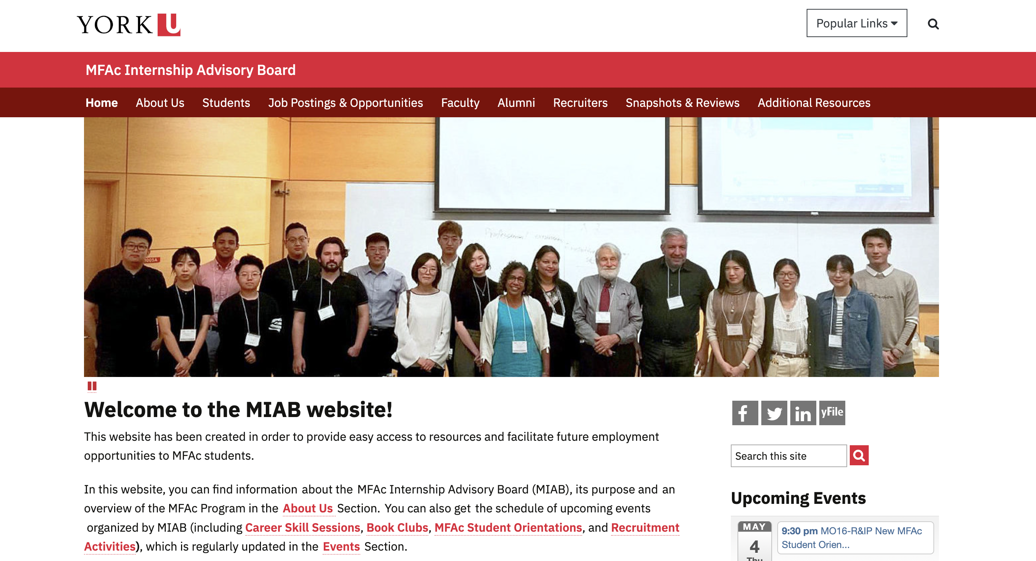
MIAB Website
You can find all information you would like to know about MIAB Website
https://miab.info.yorku.ca/#
Notes:
Reviewed by IntAdvWG Sat22Jan22
Reviewed by IntWG Mon24Jan22

Slide 25
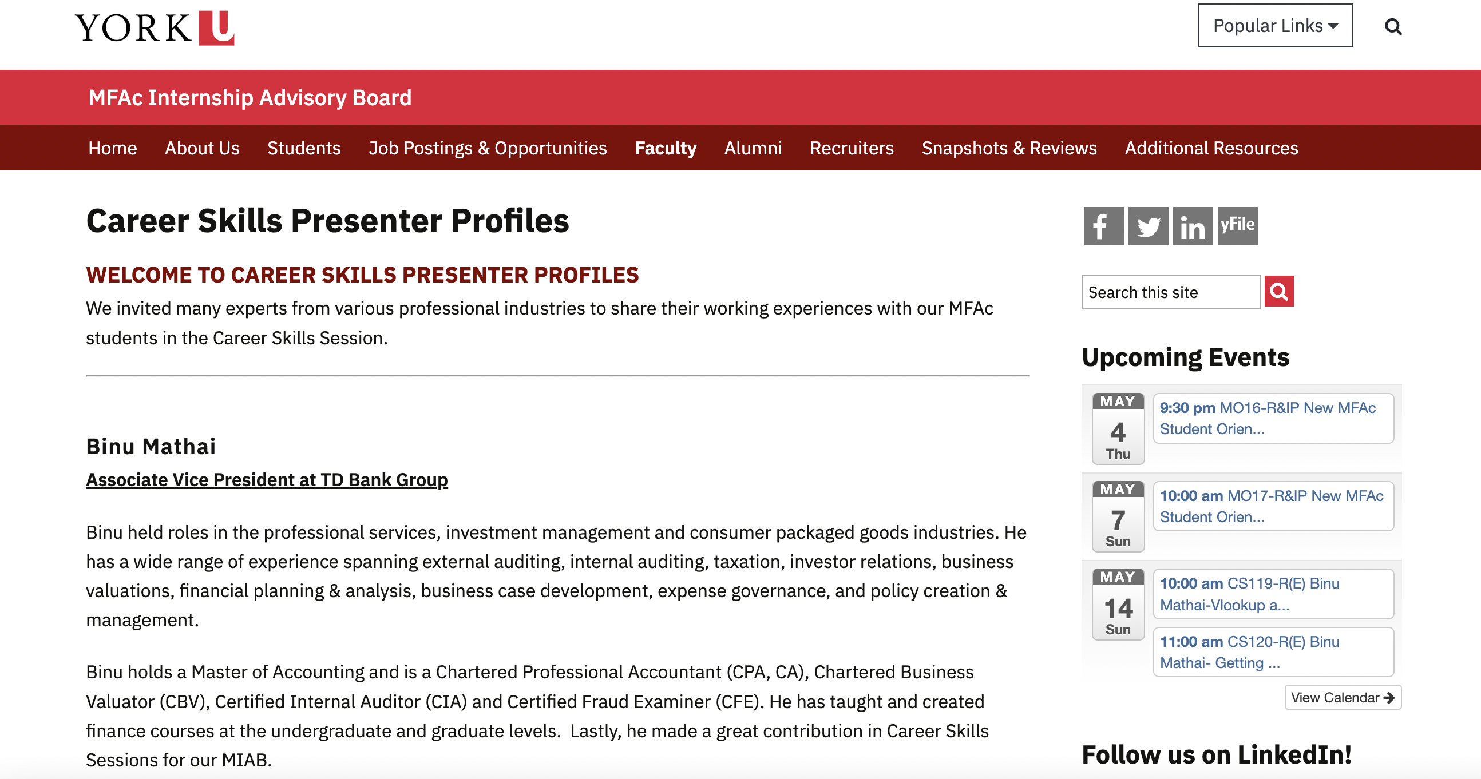
MIAB Website
Career Skills Sessions Scheduled for Summer term
Notes:
Reviewed by IntAdvWG Sat22Jan22
Reviewed by IntWG Mon24Jan22

Slide 26
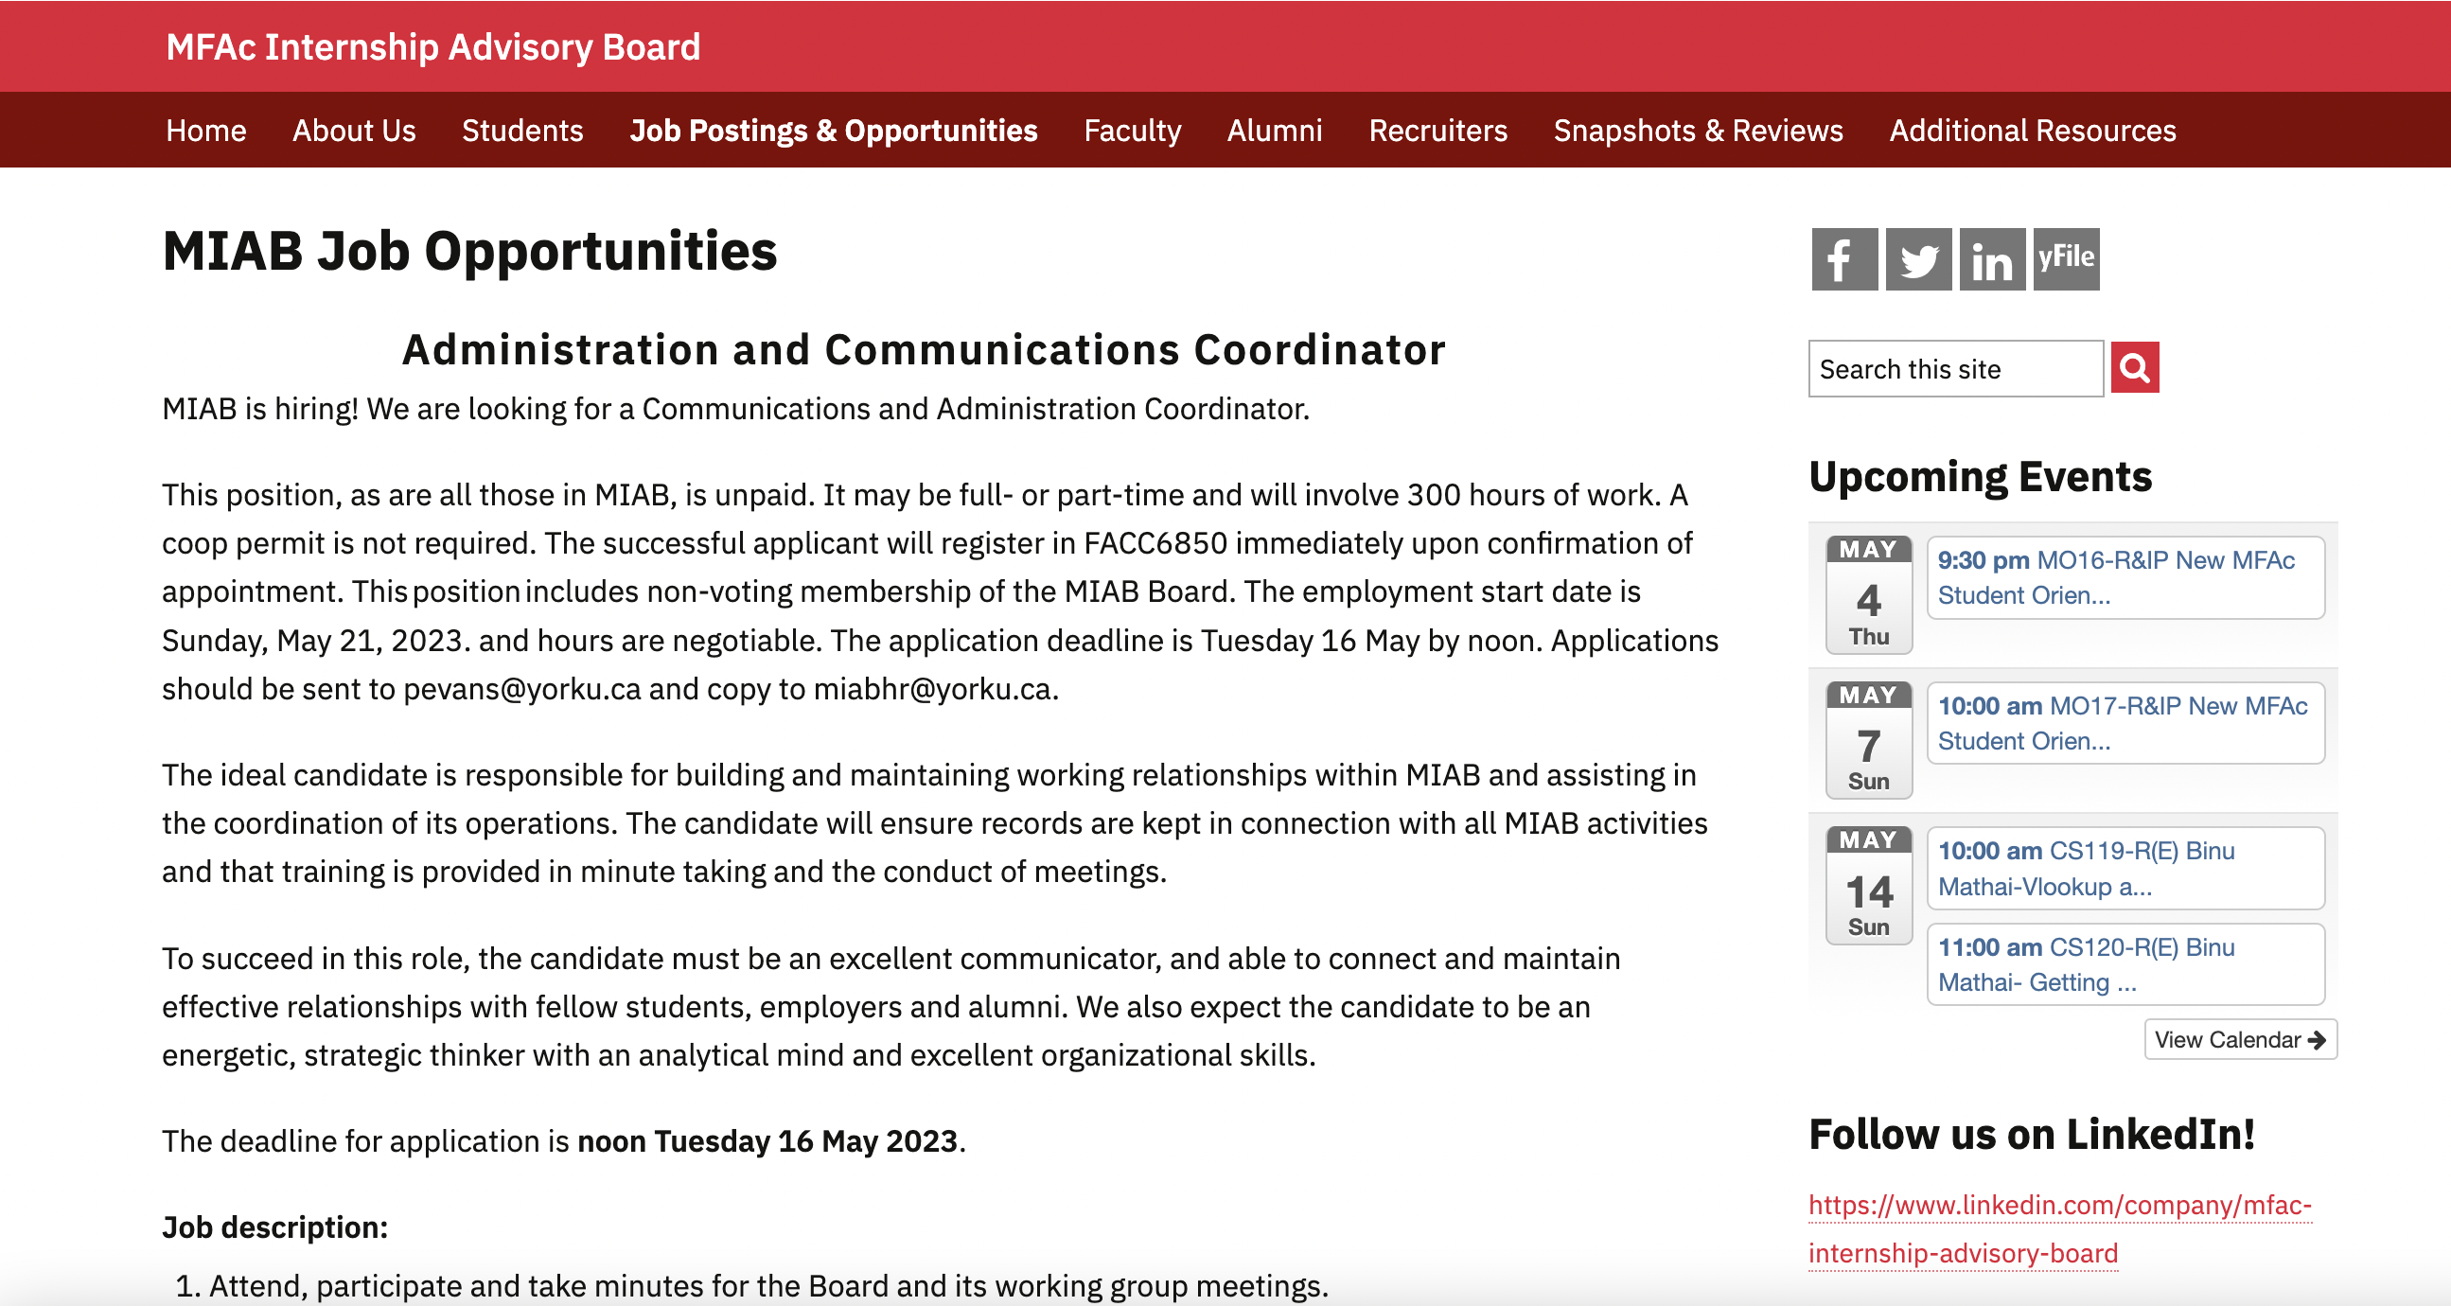
MIAB Website
Employment Information
Notes:
Reviewed by IntAdvWG Sat22Jan22
Reviewed by IntWG Mon24Jan22

Slide 27
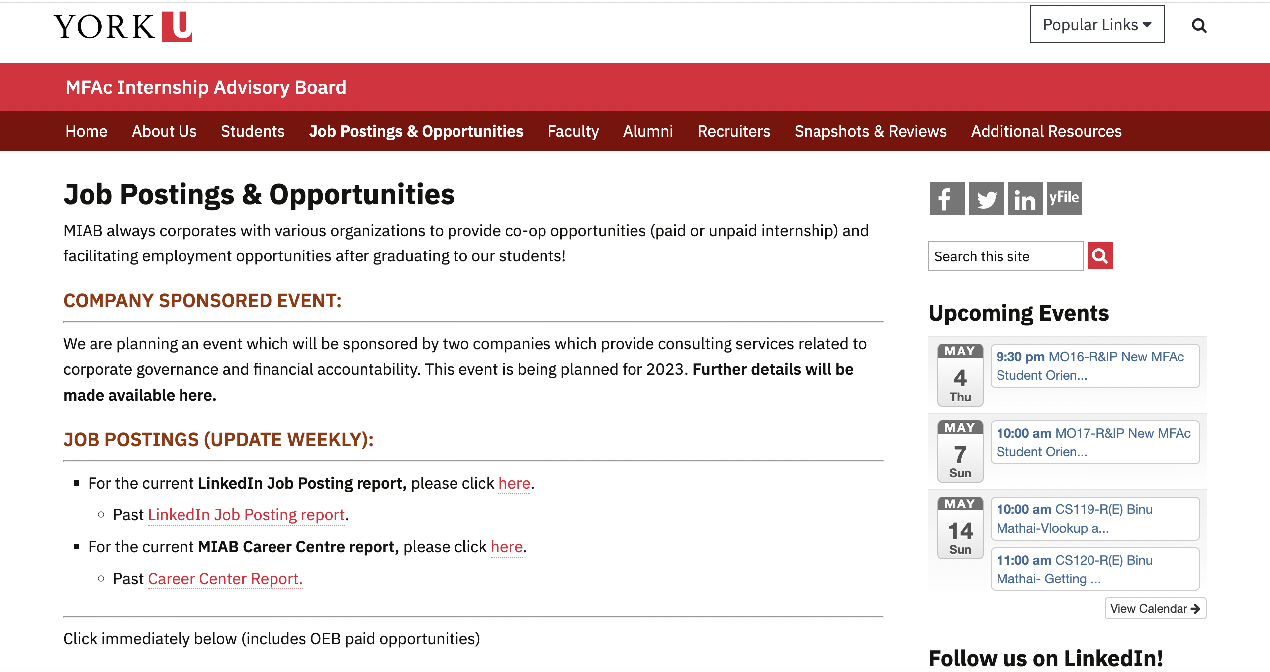
MIAB Website
Internship/Job Opportunities
Notes:
Reviewed by IntAdvWG Sat22Jan22
Reviewed by IntWG Mon24Jan22

Slide 28
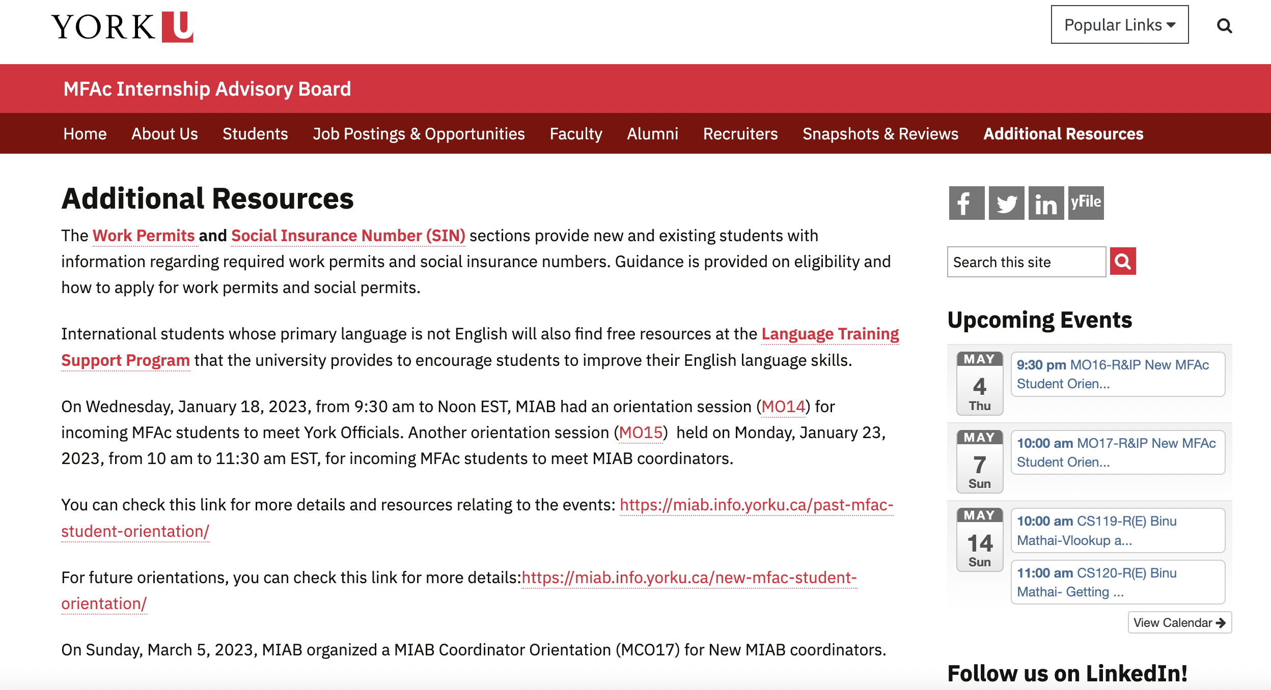
MIAB Website
Additional University Resources
Notes:
Reviewed by IntAdvWG Sat22Jan22
Reviewed by IntWG Mon24Jan22

Slide 29
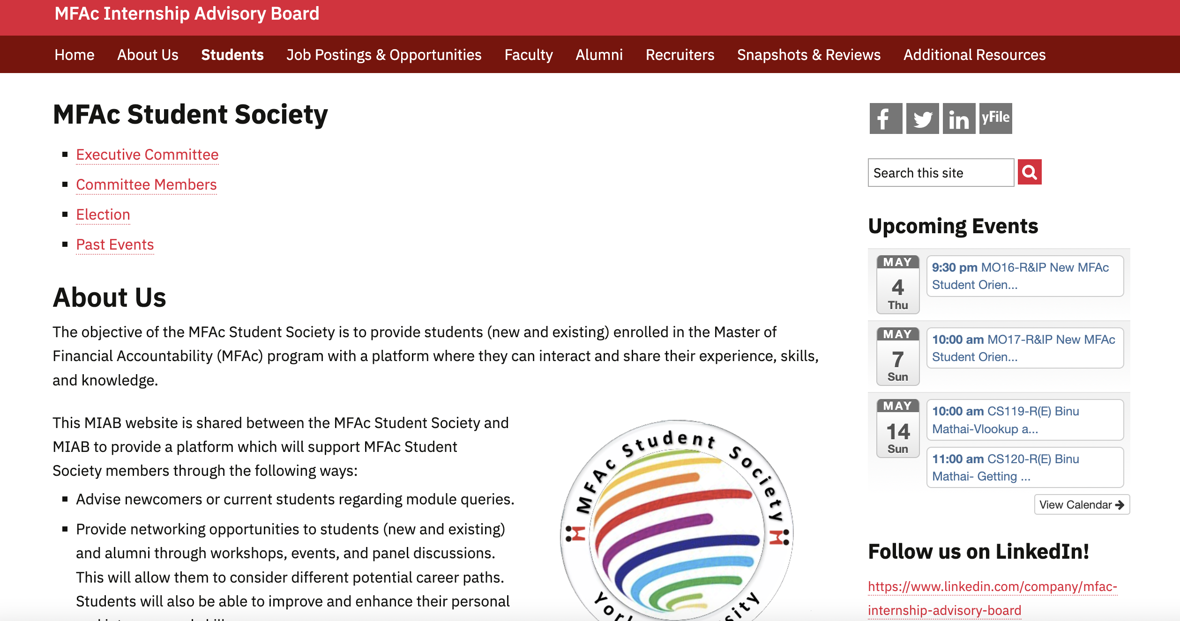
MIAB Website
MFAc Student Society
Notes:
Reviewed by IntAdvWG Sat22Jan22
Reviewed by IntWG Mon24Jan22

Slide 30
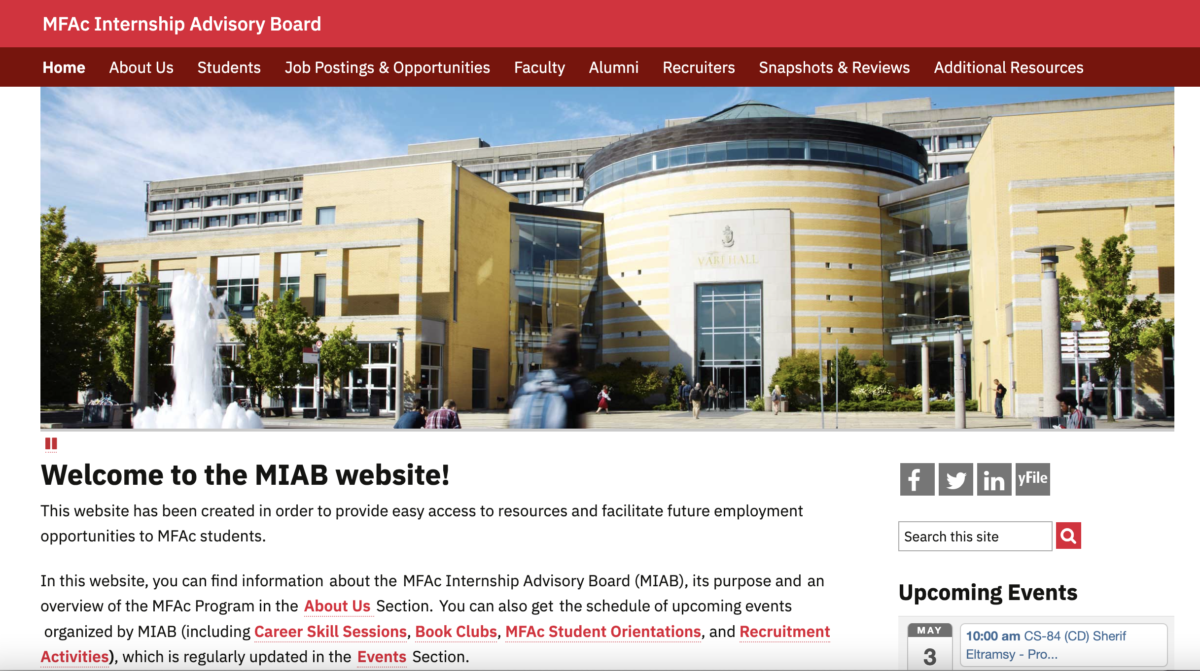
MIAB Website
The BEST place for those interested in internships to stay tuned for any updates within the program. ​
You can find it at https://miab.info.yorku.ca/, we will keep improving our website and welcome any suggestions from you! ​
MIAB LinkedIn ​
https://www.linkedin.com/company/mfac-internship-advisory-board
Student Newsletters
https://miab.info.yorku.ca/student-newsletter-2/
Notes:
Reviewed by IntAdvWG Sat22Jan22
Reviewed by IntWG Mon24Jan22

Slide 31
For further information email
miabuni@yorku.ca

Slide 32
Career Skill Sessions
Kunyuan (Ashley) Chen

Slide 33
Job description-Kunyuan (Ashley) Chen
Develop and execute networking and career skills, and orientation events.
Help students register for each event and maintain attendance records for all events.
Responsible for communications with students and presenters.
Create survey for each event and collect the feedback from students
Prepare career skill certificate for students who required.
Arrange for payment of presenters and financial transactions associated with events.
Career Session Coordinator

Slide 34
Registration
To participate, please register by clicking on Registration.

Slide 35
2023 Winter Career Skill Sessions
 | Content | Date | Time
CS108-R(E) | Binu Mathai-Pivot tables and Pivot graphs in Excel | Saturday, January 14, 2023 | 10am-11am
CS109-R&IP(CD) | Sherif Eltramsy- Job hunting skills | Saturday, January 28, 2023 | 10am-11am
CS110-R (CD) | Zahid Islam- Resume preparation and behavioural interview | Sunday, January 29, 2023 | 11am-noon
CS111-R(E) | Binu Mathai-Goal Seek and Data Validation in Excel | Saturday, February 4, 2023 | 10am-11am
CS112-R&IP(CD) | Sherif Eltramsy- Risk Management from a practical point of view | Saturday, February 11, 2023 | 10am-11am
CS113-R(E) | Binu Mathai-Understanding the Table function in Excel | Saturday, February 18, 2023 | 10am-11am
CS114-R(E) | Binu Mathai-Sumif, sumifs, countif, averageif, maxif, sumproduct in Excel | Saturday, March 4, 2023 | 10am-11am
CS115-R(E) | Binu Mathai-Slicers in Excel | Saturday, March 18, 2023 | 10am-11am
CS116-R(CM) | Binu Mathai-Tips on e-mail communnication in CM | Saturday, March 25, 2023 | 10am-11am
CS117-R(E) | Binu Mathai-Creating a presentation to assess a strategic proposal in powerpoint | Saturday, April 1, 2023 | 10am-11am
This summer we plan three types of activities. To help you develop your
career and internship skills, MIAB
(MFAc Internship Advisory Board)
plans to offer MFAc students with
distinct sessions in three primary areas:
Part 1: Career preparation skills (CD)
Part 2: Presentation skills using PowerPoint (PS)
Part 3: Excel skills (E)
Notes:
Reviewed by IntWG Mon24Jan22

Slide 36
How to apply?
Email your request to miabenrl@yorku.ca upon completion of the requisite hours
For more details, please refer to the MIAB website at https://miab.info.yorku.ca/career-skills-sessions/
Notes:
Reviewed by IntWG Mon24Jan22

Slide 37
Book Club
BC | Content | Date | Time
BC14-R | The Power of Crisis by Ian Bremmer | Tuesday, January 24, 2023 | 7pm-9pm
BC15-IP | Making Numbers Count by Chip Heath and Karla Starr | Tuesday, March 7, 2023 | 5:30pm-7:30pm
BC16-R | The Power of Knowing When to Walk Away by Annie Duke | Tuesday, April 11, 2023 | 5:30pm-8pm
BC17-IP | The Power of Geography: Ten Maps that Reveal the Future of Our World by Tim Marshall | Tuesday, May 23, 2023 | 5:30pm-8pm
BC18-IP | Dead in the Water: Murder and Fraud in the World's Most Secretive Industry by Matthew Campbell | Tuesday, June 27, 2023 | 5:30pm-8pm
Notes:
Reviewed by IntWG Mon24Jan22

Slide 38
Financial Modelling Fundamentals Instruction Program (FMFIP)
This program is for students and alumni who are interested in financial modelling and would like to have more financial modelling skills. The nine sessions will be delivered remotely over three days, and students must attend all three days' class sessions. is prog
ram is for students and alumni who are interested in financial modelling and would like to have more financial modelling skills. The nine sessions will be delivered remotely over three days, and students must attend all three days' class sessions.
Session | Topics | Date | Time
1 | Overview + foundation technical skills | Saturday, March 4, 2023 | 12pm-1pm
2 | Model design | Saturday, March 4, 2023 | 1pm-2pm
3 | Revenues | Saturday, March 4, 2023 | 2pm-3pm
4 | Costs + financial statements | Saturday, March 11, 2023 | 12pm-1pm
5 | Depreciation | Saturday, March 11, 2023 | 1pm-2pm
6 | Income taxes | Saturday, March 11, 2023 | 2pm-3pm
7 | Working capital | Saturday, March 18, 2023 | 12pm-1pm
8 | Debt and equity | Saturday, March 18, 2023 | 1pm-2pm
9 | Other considerations + wrap-up | Saturday, March 18, 2023 | 2pm-3pm

Slide 39
Student Interface
Hao (Alexendra) Zheng

Slide 40
Student Interface – Hao (Alexendra) Zheng
Assisting students who are interested in FACC 6850 to register for the FACC 6850 Pre-registration Orbis Platform (PROP) and FACC 6850 Practicum Course;
According to the student information and documents provided to understand students’ intentions and provide better services;
Helping MFAc students to request IRCC letters that students can apply for Co-op Work Permit.
For more information about Co-op Work Permit and Post Graduate Work Permit, please visit the MIAB website through this link: https://miab.info.yorku.ca/work-permits/
miabstud@yorku.ca
Notes:
Reviewed by IntWG Wed22Dec21
Reviewed by IntAdwg Sat8Jan22

Slide 41
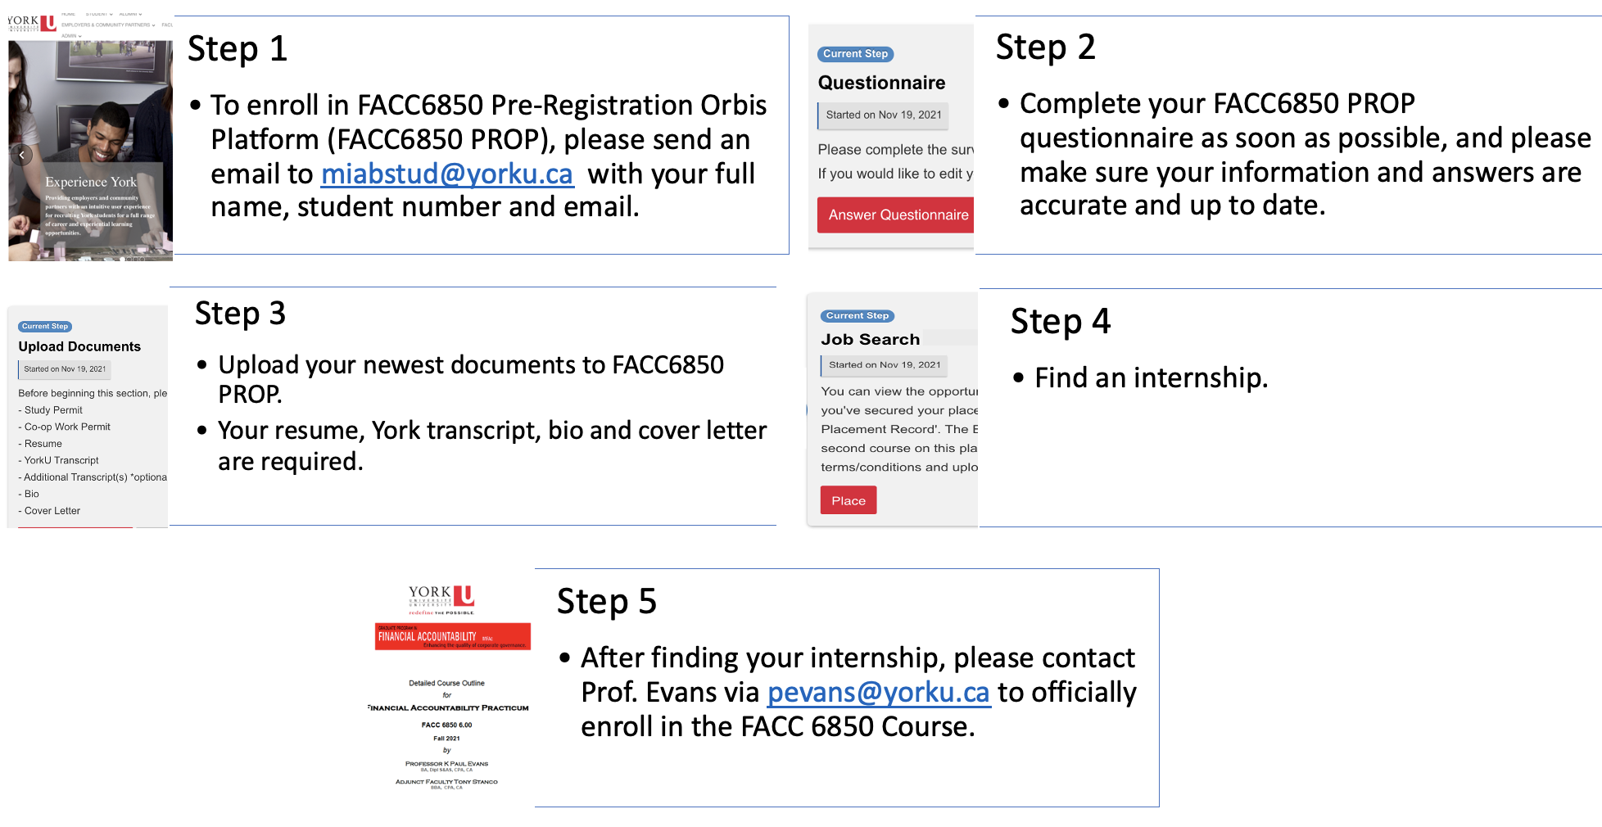
FACC 6850 Pre-registration Orbis Platform (PROP)
For more information about FACC6850 PROP, please visit the MIAB website via this link: https://miab.info.yorku.ca/orbis-system-instruction/
Notes:
Reviewed by IntWG Wed22Dec21
Reviewed by IntAdwg Sat8Jan22

Slide 42
FACC 6850 Practicum Course - Introduction to Accountability & Governance
FACC6850 is a practicum course that counts for 6.0 credits. Also, you can use it for your entire electives or in addition.
FACC 6850 Practicum Course provides students an opportunity to work in a financial accountability related position. The placement allows students to observe professionals at work and will give them the opportunity to apply their theoretical knowledge to live situations or projects.
Prerequisites
FACC 6000 – Introduction to Accountability & Governance
You can only apply for the FACC6850 course if you have a job.
For more information about the FACC6850 course, please visit the MIAB website via this link: https://miab.info.yorku.ca/what-happens-once-they-are-enrolled-in-facc-6850/
Notes:
Reviewed by IntWG Wed22Dec21
Reviewed by IntAdwg Sat8Jan22

Slide 43
Employer Interface
Haowen (Irene) Liu
Introduced by Dammy Atekoja

Slide 44
Employer Interface Haowen (Irene) Liu
Help students to find suitable internships.
Together with the Student Contact Coordinator we are responsible for tracking students and employment opportunities.
Follow up with the people who are doing internships.
Find out about potential future internship opportunities.
We solidify our relationships with employers by recommending the appropriate students and then providing good feedback from the employers.
Search for employer events and career center employment opportunities and make our students aware of them.
MIAB has connections with many not-for-profit organizations that can help you improve your chances of finding internships in this kind of organization.
Maibempl@yorku.ca
Notes:
Reviewed by IntWG Wed22Dec21
Reviewed by IntAdwg Sat8Jan22

Slide 45
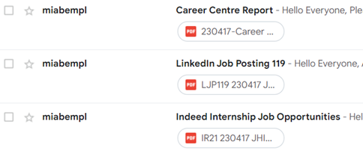
Job Postings: https://miab.info.yorku.ca/media/

Slide 46
Career event with Scotiabank
The event is expected to be held at the end of June.

Slide 47
Intern and Adviser Placement Coordinator
Lu Zhang, introduced by Dammy Atekoja

Slide 48
Intern and Adviser Placement Coordinator – Lu Zhang
Assist with finding internships for past coordinators/interns who are interested in further internships
Work with current students to identify their areas/industry interest to provide opportunities for internship/employment opportunities
Work closely with colleague coordinators to respond to student enquiries and onboarding into FACC 6850
Assist with providing/directing students to helpful resources to facilitate their internship placement
Help provide answers to students who have questions on the MIAB program

Slide 49
After joining the FACC 6850
FACC 6850
External
MIAB
MIAB
Transfer
External
300 hours in total
Notes:
Reviewed by IntWG Wed22Dec21
Reviewed by IntAdwg Sat8Jan22

Slide 50
Alumni and Mentoring Coordinator
Han Xu

Slide 51
Alumni and Mentoring Coordinator Han Xu
Managing MIAB Mentoring Program.
Matching mentors and mentees.
Developing potential mentees and mentors.
After the mentor accepts the mentee and vice versa, send both mentee and mentor the MIAB - Confidentiality Agreement and request to sign.
Then the mentoring session can start.
Following the mentoring progress.
Miabment@yorku.ca
Link: https://miab.info.yorku.ca/career-mentor-program-2/
Notes:
Reviewed by IntWG Wed22Dec21
Reviewed by IntAdwg Sat8Jan22

Slide 52
Alumni Activities
Networking Event
Plan to hold an in-person event which may be a case competition in this semester.
Will give our MFAc students and alumni an opportunity to network and exchange work experiences.
Goals: Hope to increase MFAc student employment opportunities. Can help students practice what they have learned in class.
If you are interested in this, please reach out to Han Xu (miabalum@yorku.ca) for more information.

Slide 53
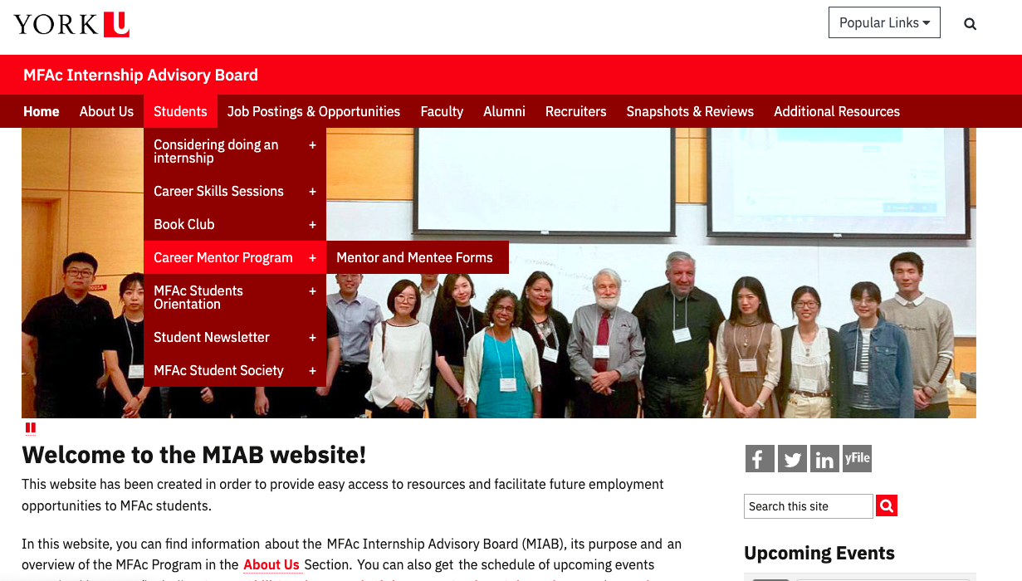

Slide 54
Thank you for listening.
Please fill out the survey.

