Slide 1
MFAc Student Society Sep 1, 2022

Slide 2
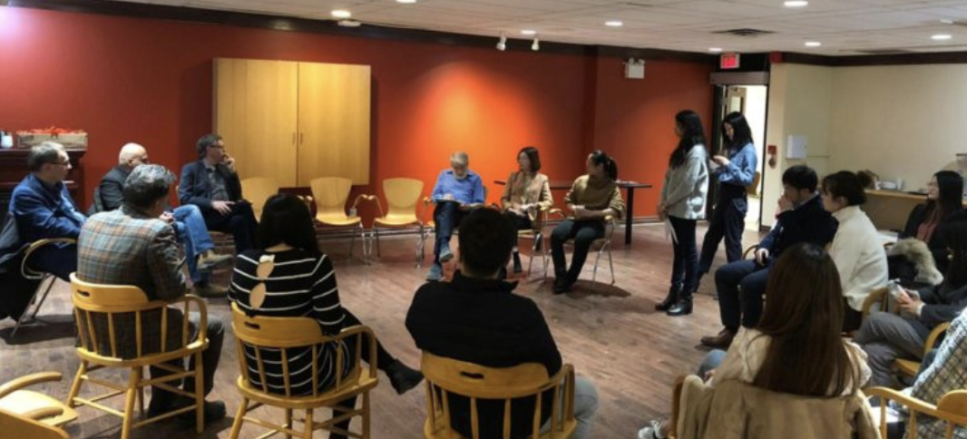
Who are we?
A platform for MFAc students where they can interact and share their experience, skills, and knowledge.
MFAc internship Advisory Board (MIAB) helps the Student Society by providing access to their administrative infrastructure and collaborates closely with us
More information can be found on our website: https://miab.info.yorku.ca/mfac-student-society-2/

Slide 3
What we do?
Advise newcomers or current students regarding modules queries
Provide networking opportunities to students (new and existing) and alumni through workshops, events and panel discussions.
This will allow them to consider different potential career paths.
Students will also be able to improve and enhance their personal and interpersonal skills
Form partnerships with employers to help students and alumni in the job search prospect

Slide 4
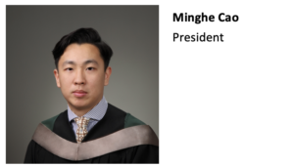
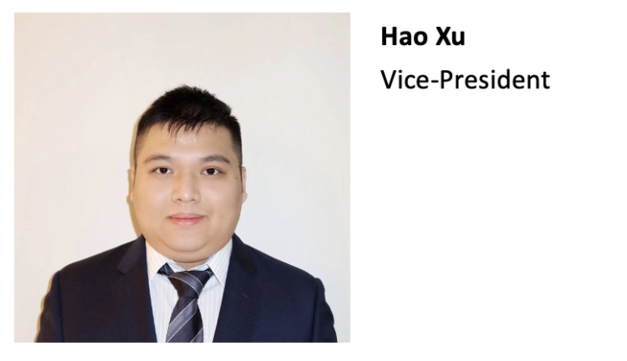
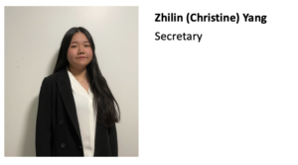
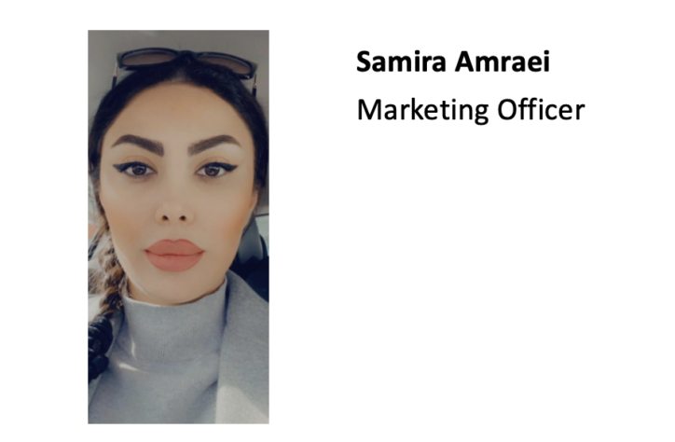
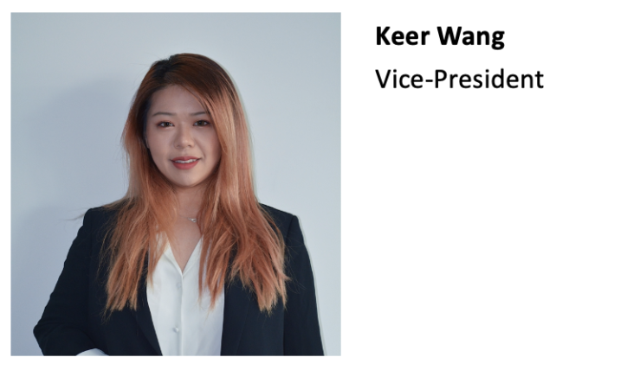
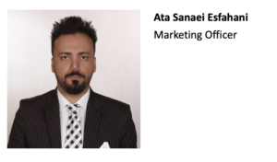
Executive Committee – Summer 2022

Slide 5
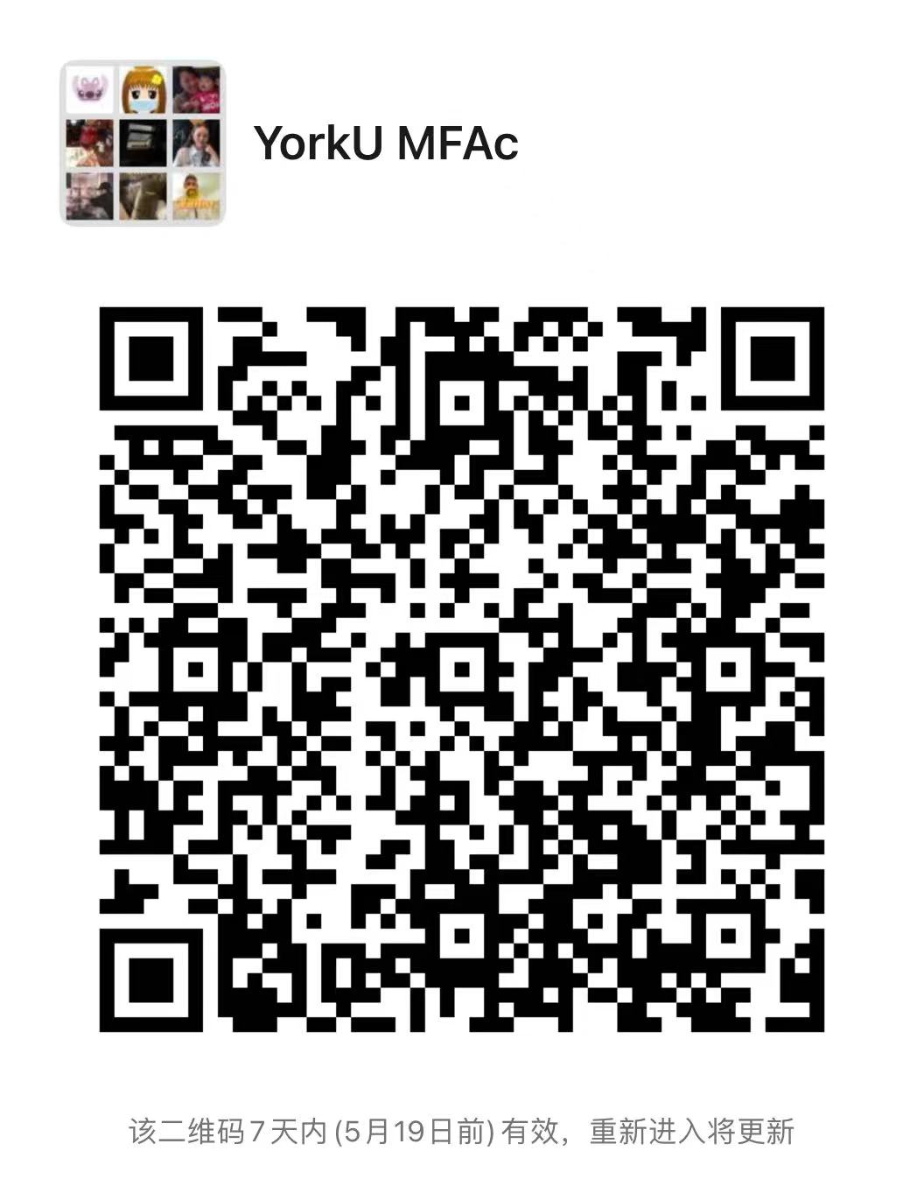
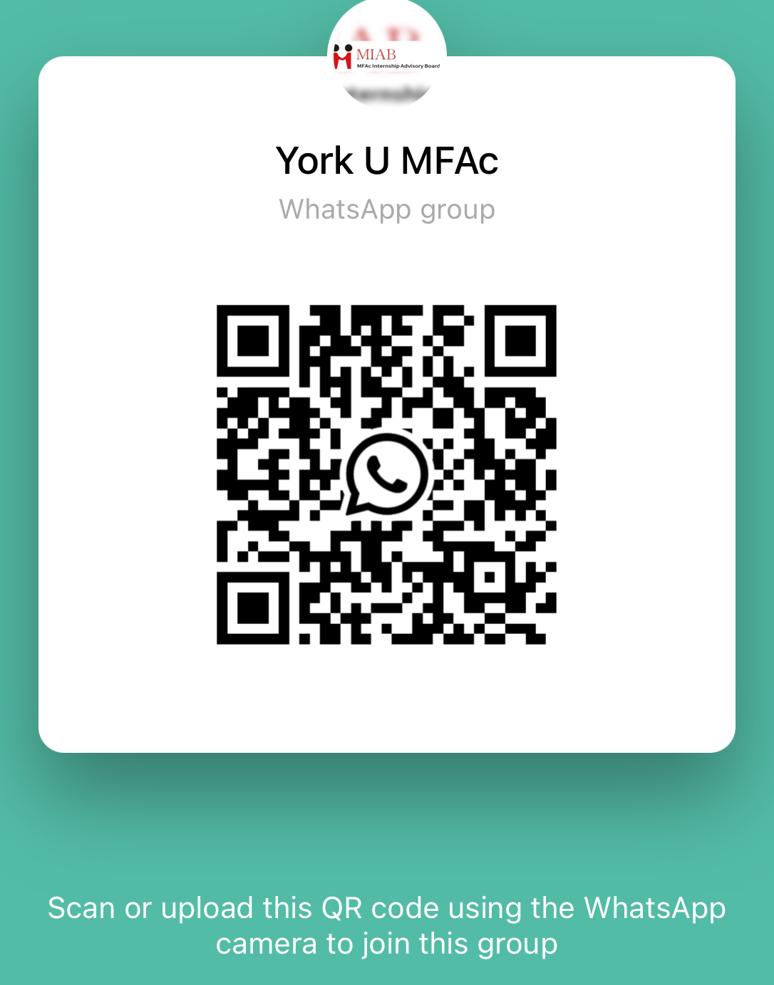
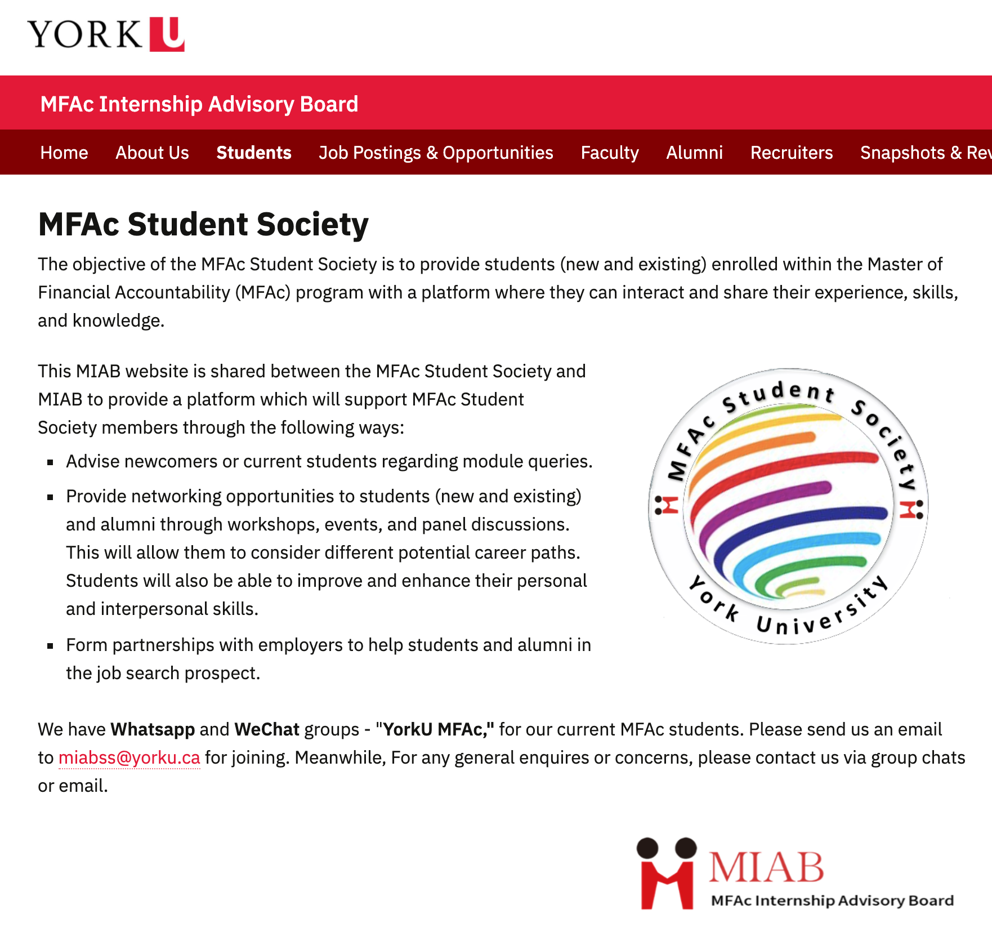
Our Activities
May 15th in-person meet-up
August 30th in-person meet-up
Webpage update
WeChat and WhatsApp communication channels
Wechat
Whatsapp

Slide 6
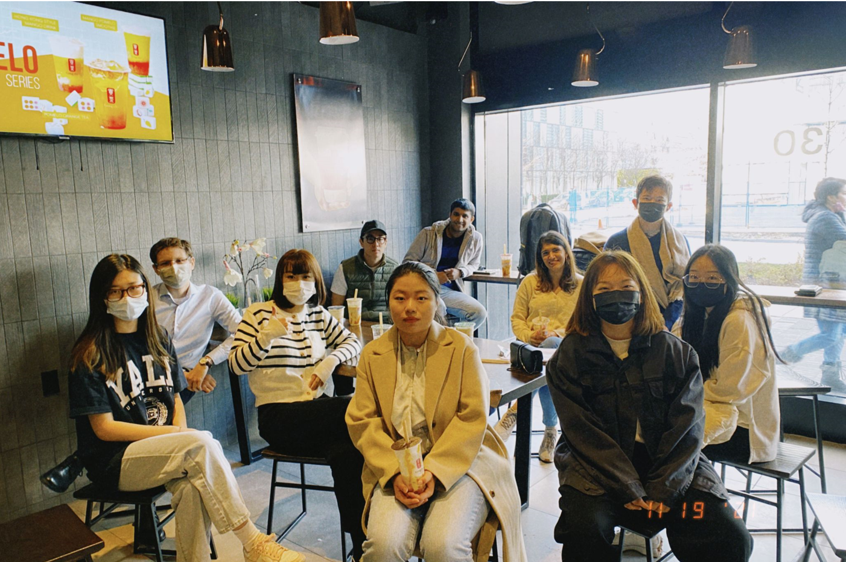
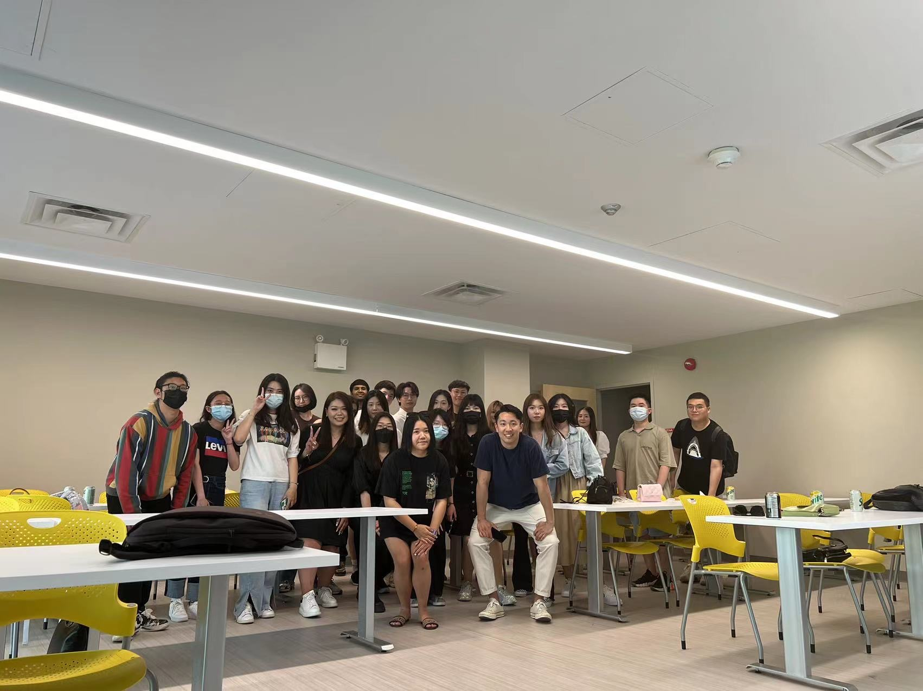
May 15th in-person meet-up
Event date: May 15th, 2022
Event time: 14:30 – 16:00
Location: Room 026 at Atkinson Building
Our aims of this event are:
To provide an occasion for MFAc students to connect with each other.
To help the students getting more familiar with the program;
To give practical tips from our alumni and students on job hunting, interview skills;

Slide 7
Aug 30th in-person frisbee meet-up （Unfortunately cancelled）
Event date: Aug 30th, 2022
Event time: N/A
Location: N/A
Our aims of this event are:
To provide an occasion for MFAc students to connect with each other.
To assist build the bond among students in a sporty yet friendly and accessible environment.

Slide 8
Thank you and welcome!
Contact Us:
miabss@yorku.ca

